Slide 1


Slide 2
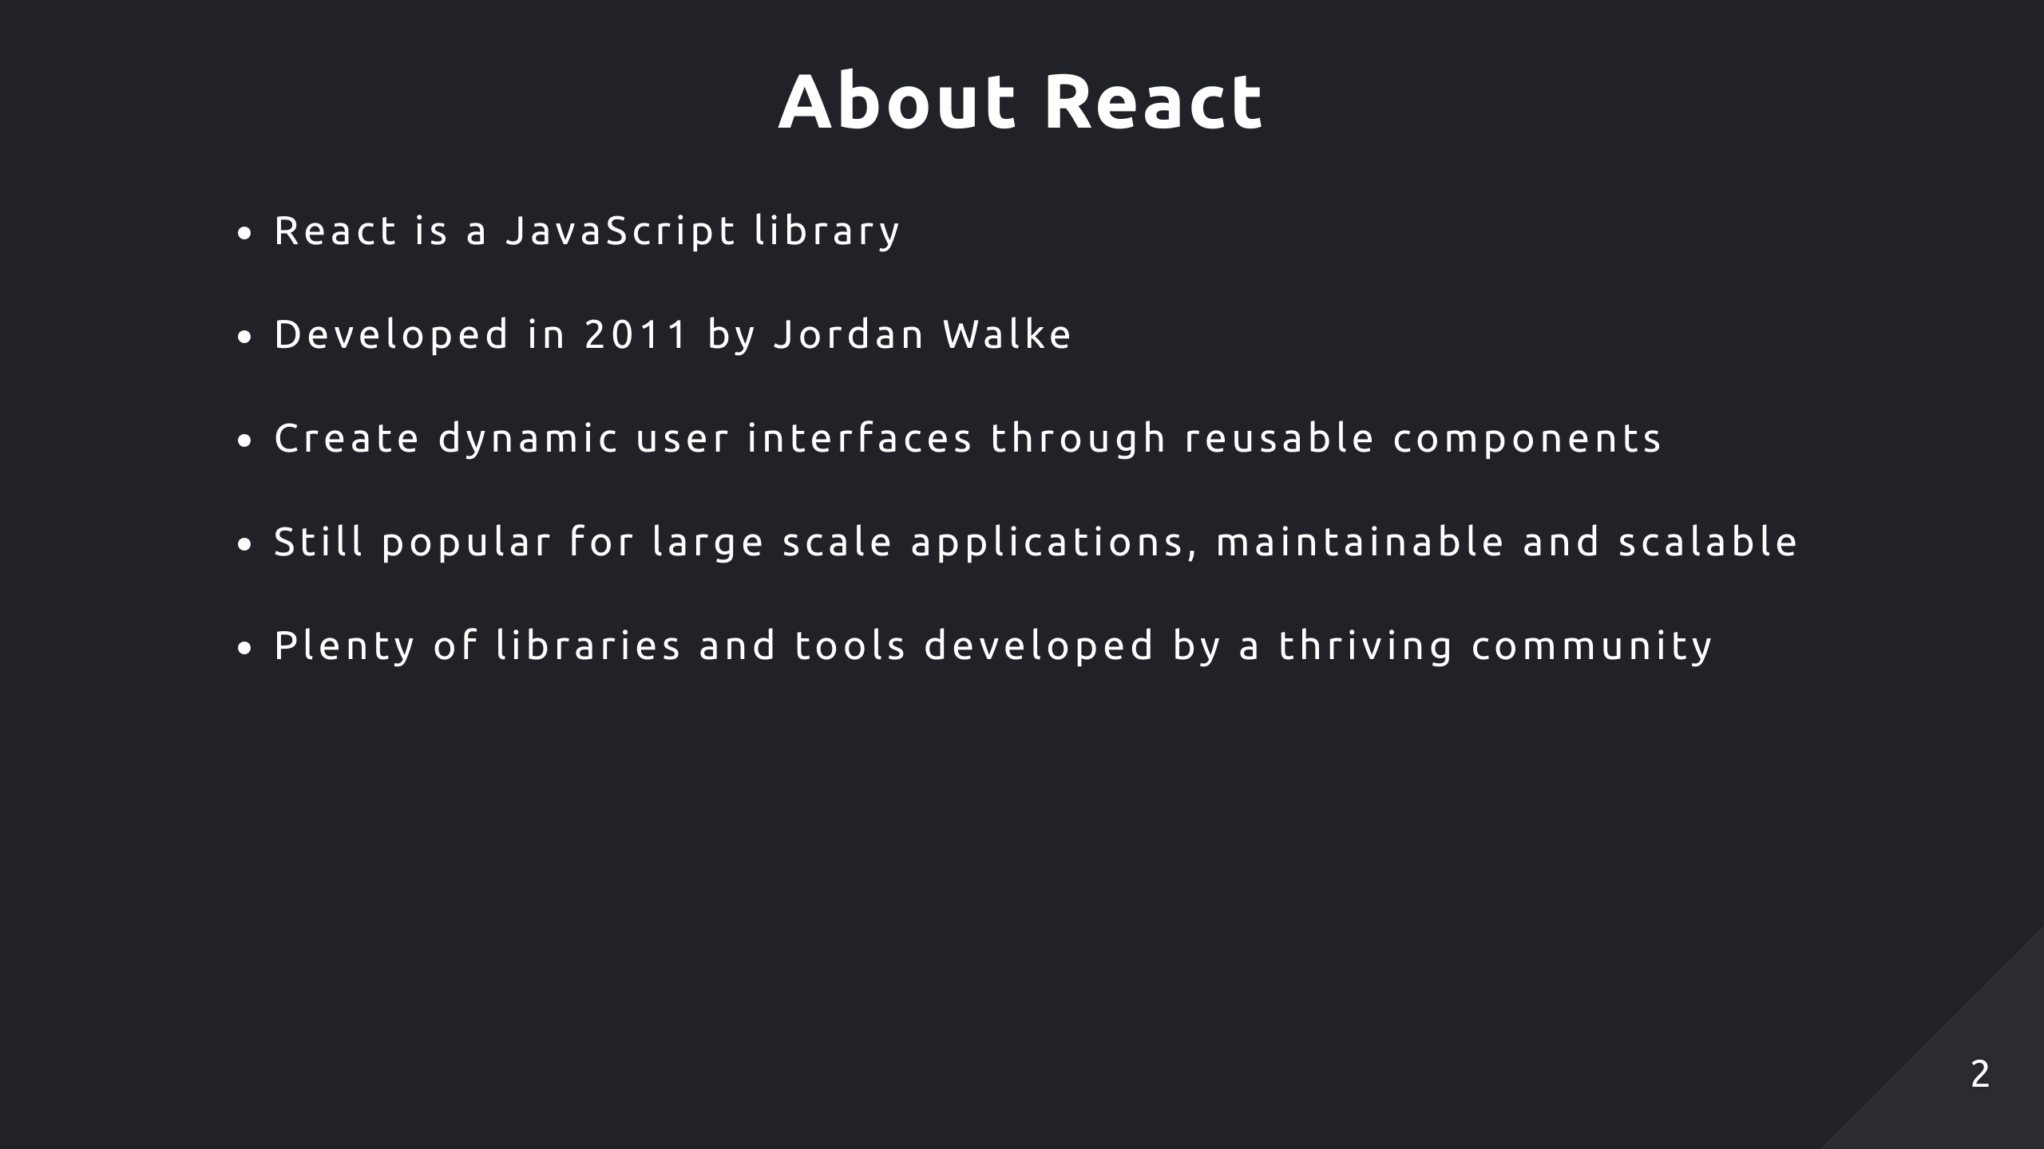
Notes:
It’s used to create dynamic user interfaces with reusable components
To this day it’s still popular for large apps, due to its maintainability and scalability
And there are plenty of libraries/tools developed by the React community to evolve the technology

Slide 3
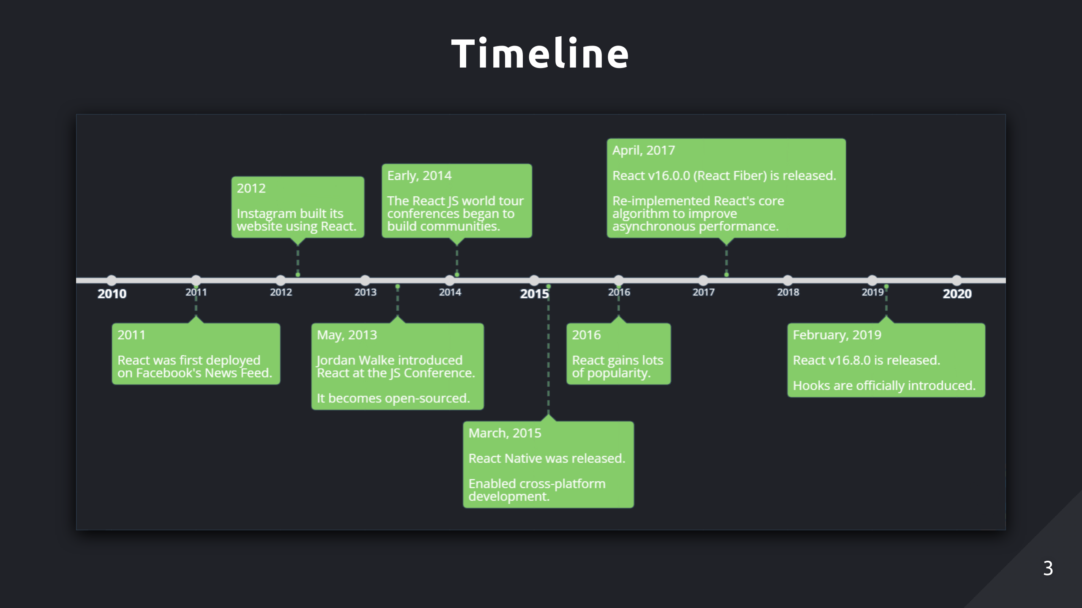
Notes:
Facebook was already using React in 2011 and 2012 to develop some of their apps, like Instagram
Shortly after, he did a world tour to present React to the world
Fiber was released, which improved rendering performance and UI responsiveness

Slide 4
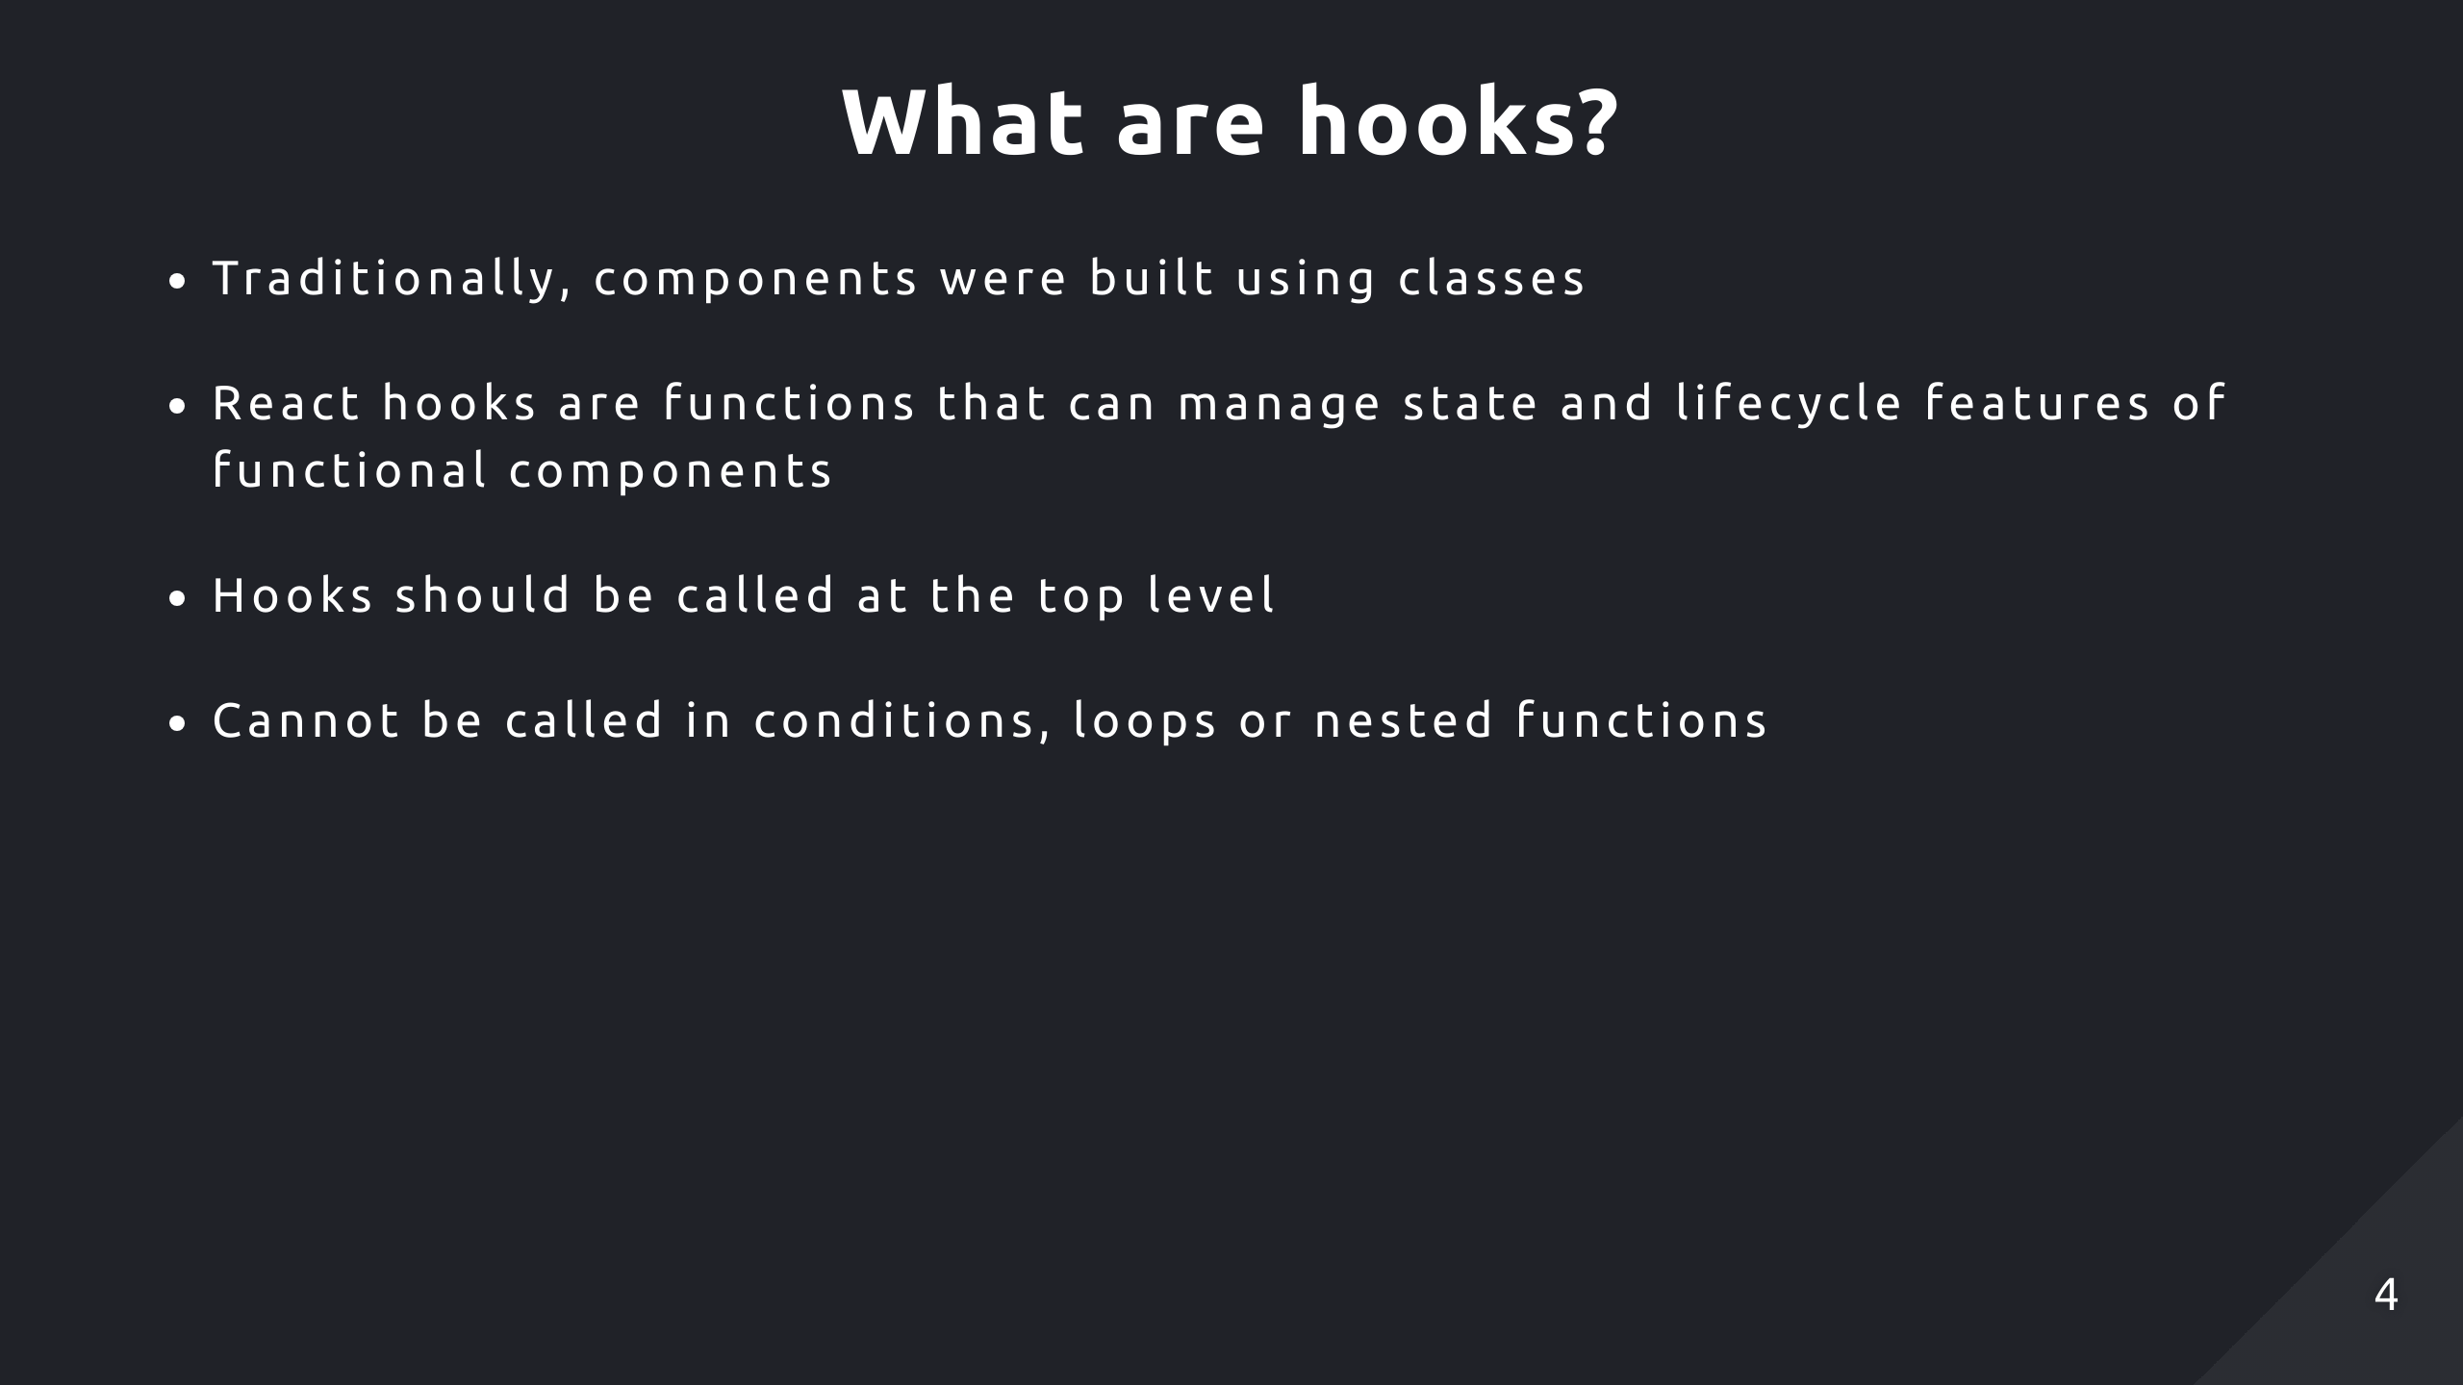
Notes:
Before hooks were introduced, components were implemented using classes
This is so React can track and manage state properly

Slide 5
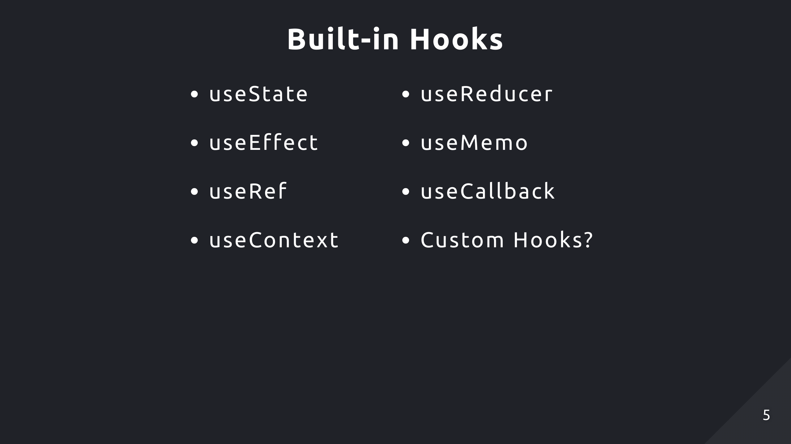
Notes:
Here’s a list of some of the more commonly used built-in hooks

Slide 6
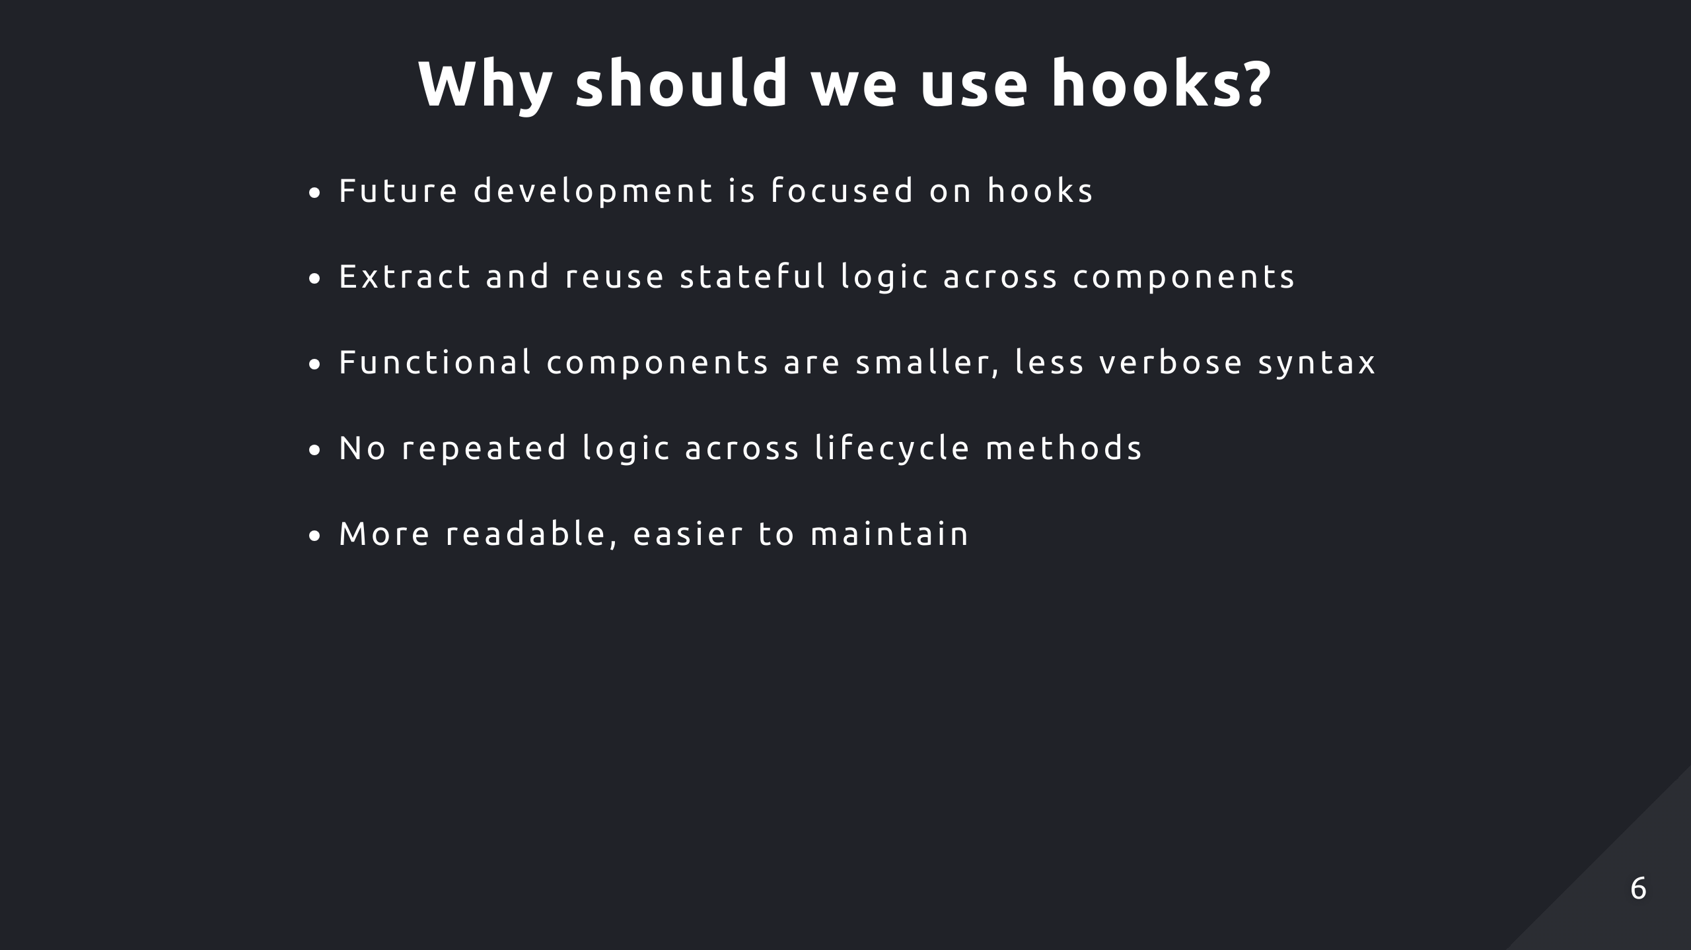
Notes:
The future of React development is focused on functional components and hooks
And generally, it’s less code to write functional components than class components because there’s less syntax

Slide 7


Slide 8
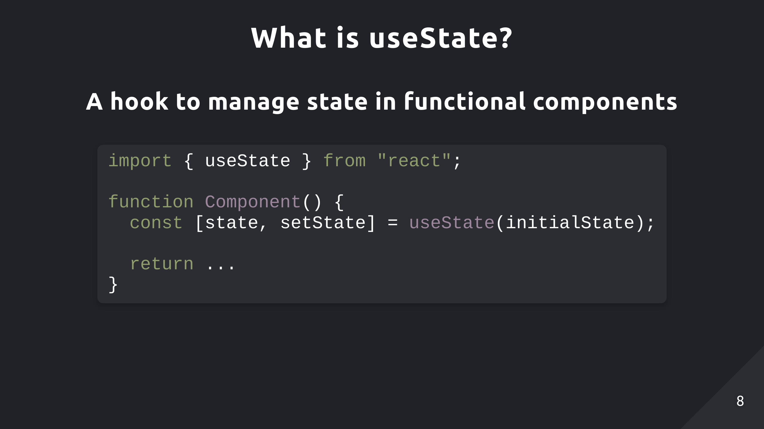

Slide 9
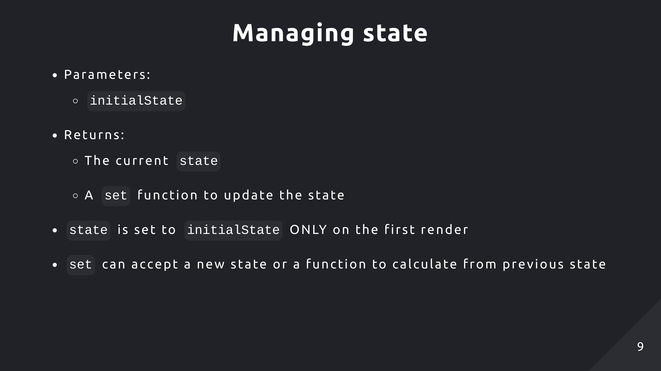
Notes:
Setter function to update the state and trigger a re-render
There are 2 ways to use the setter, you can pass in the new state directly or a function imports the previous state and calculates the next state based off that

Slide 10
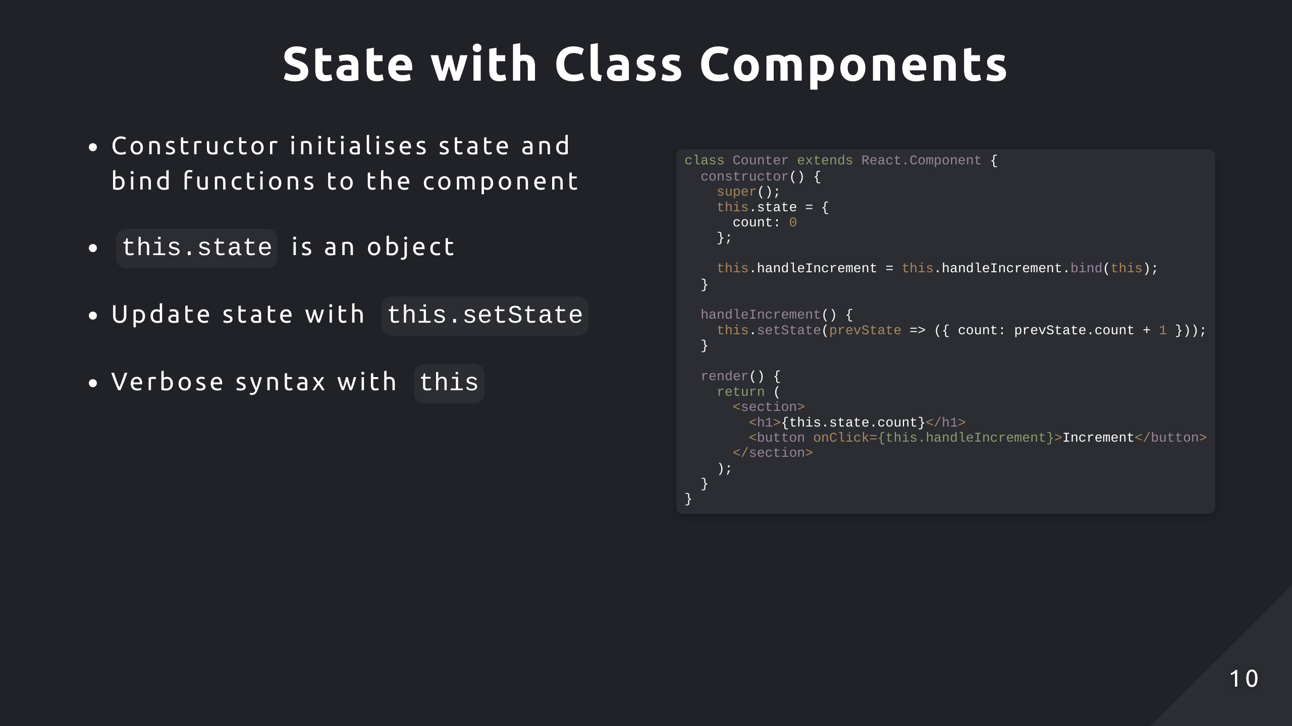
Notes:
We have a simple counter component which increments a counter when a button is clicked
So already the code is verbose with the this syntax everywhere

Slide 11
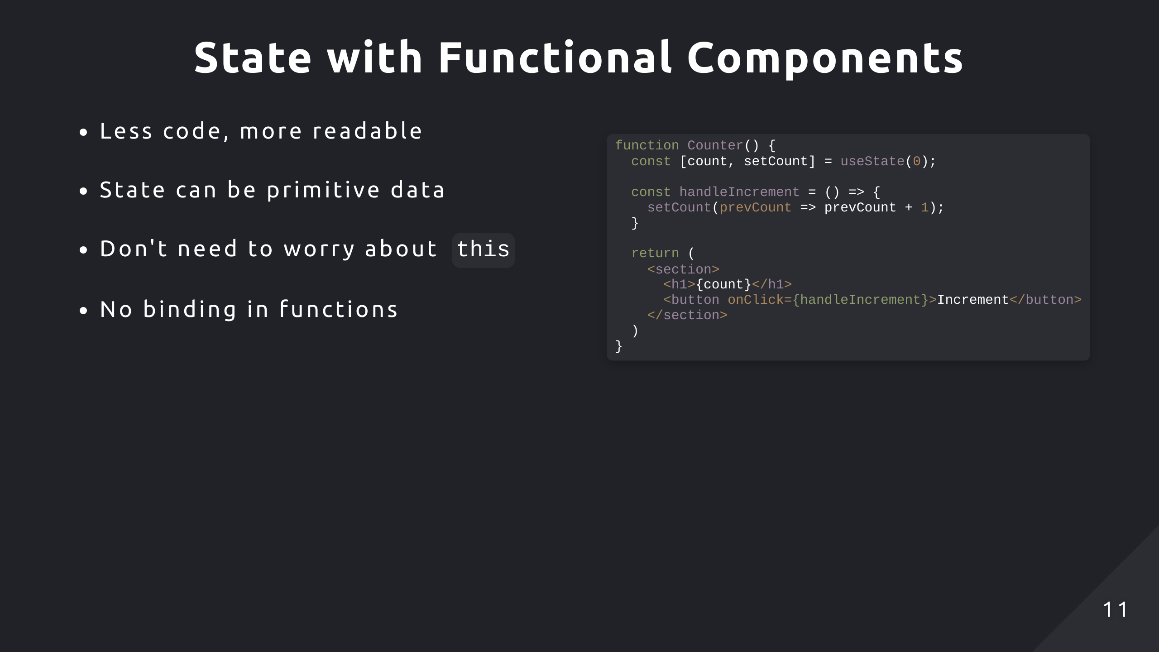
Notes:
So here we have the exact same application but written using a functional component
Already the code looks more lean without all the this syntax
State also isn’t restricted to being an object, it can be a primitive

Slide 12
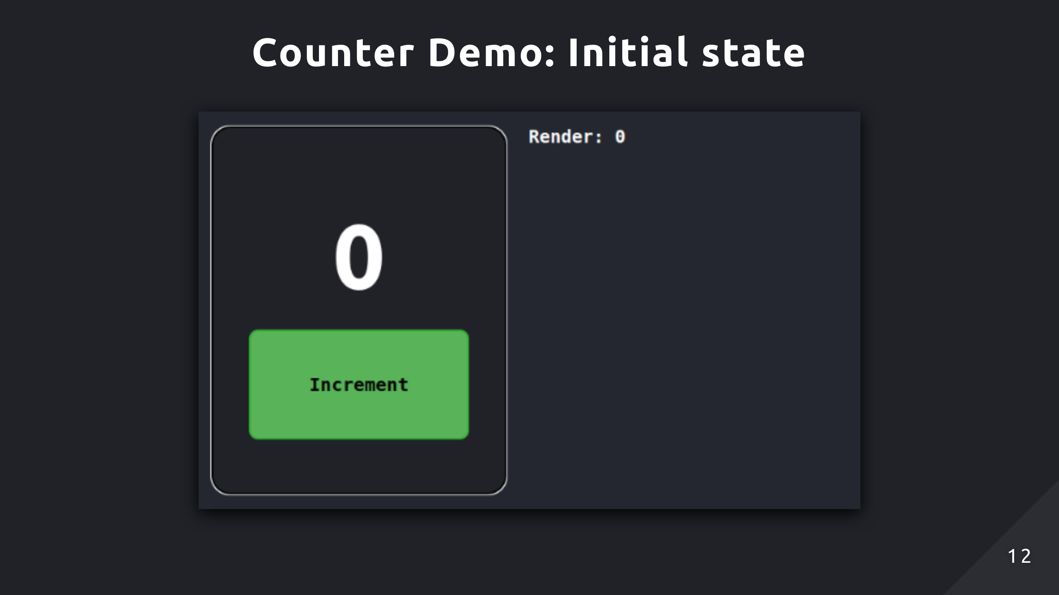
Notes:
So here is what the app would look like on the initial render
The counter is 0 because we haven’t interacted with it yet

Slide 13
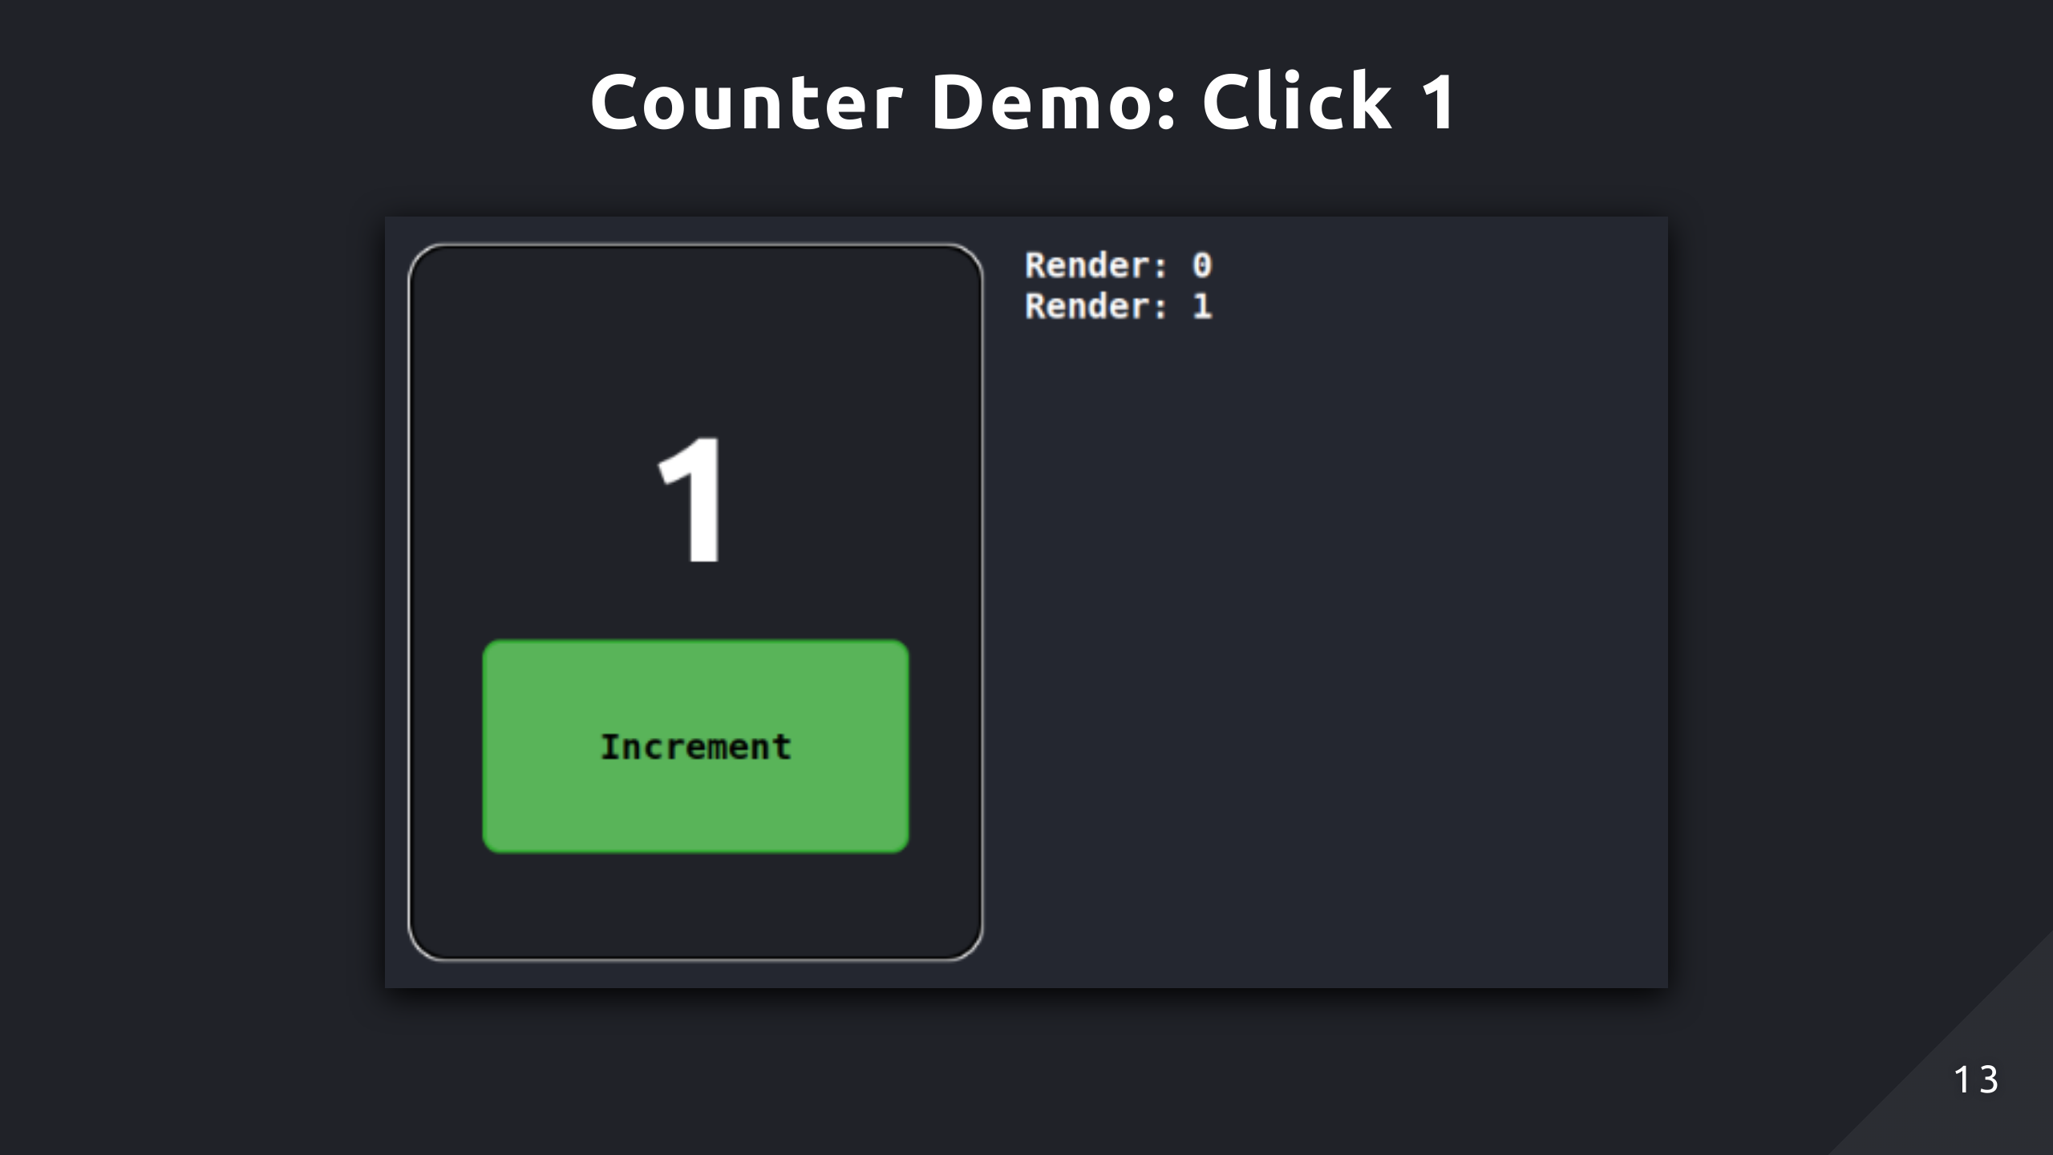
Notes:
When we click increment, it updates the state and triggers a re-render
Now it displays 1

Slide 14
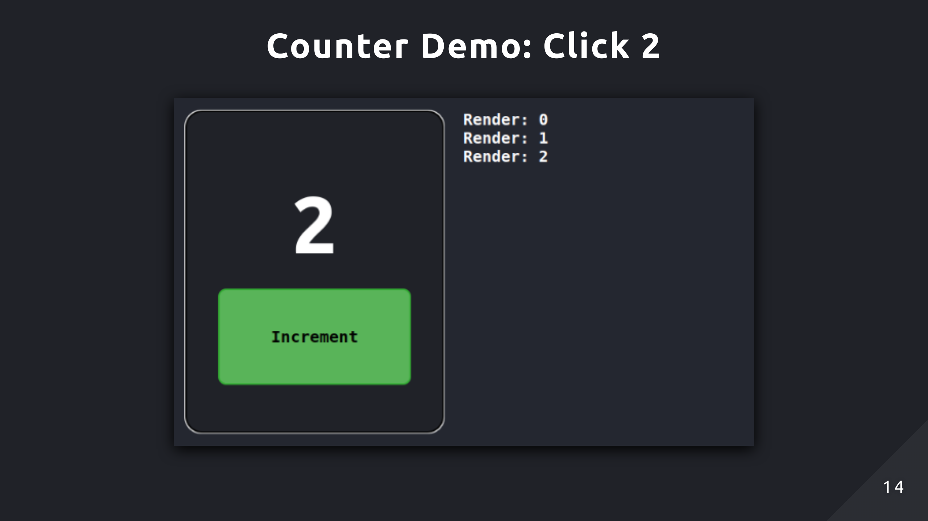
Notes:
The same thing will occur here

Slide 15
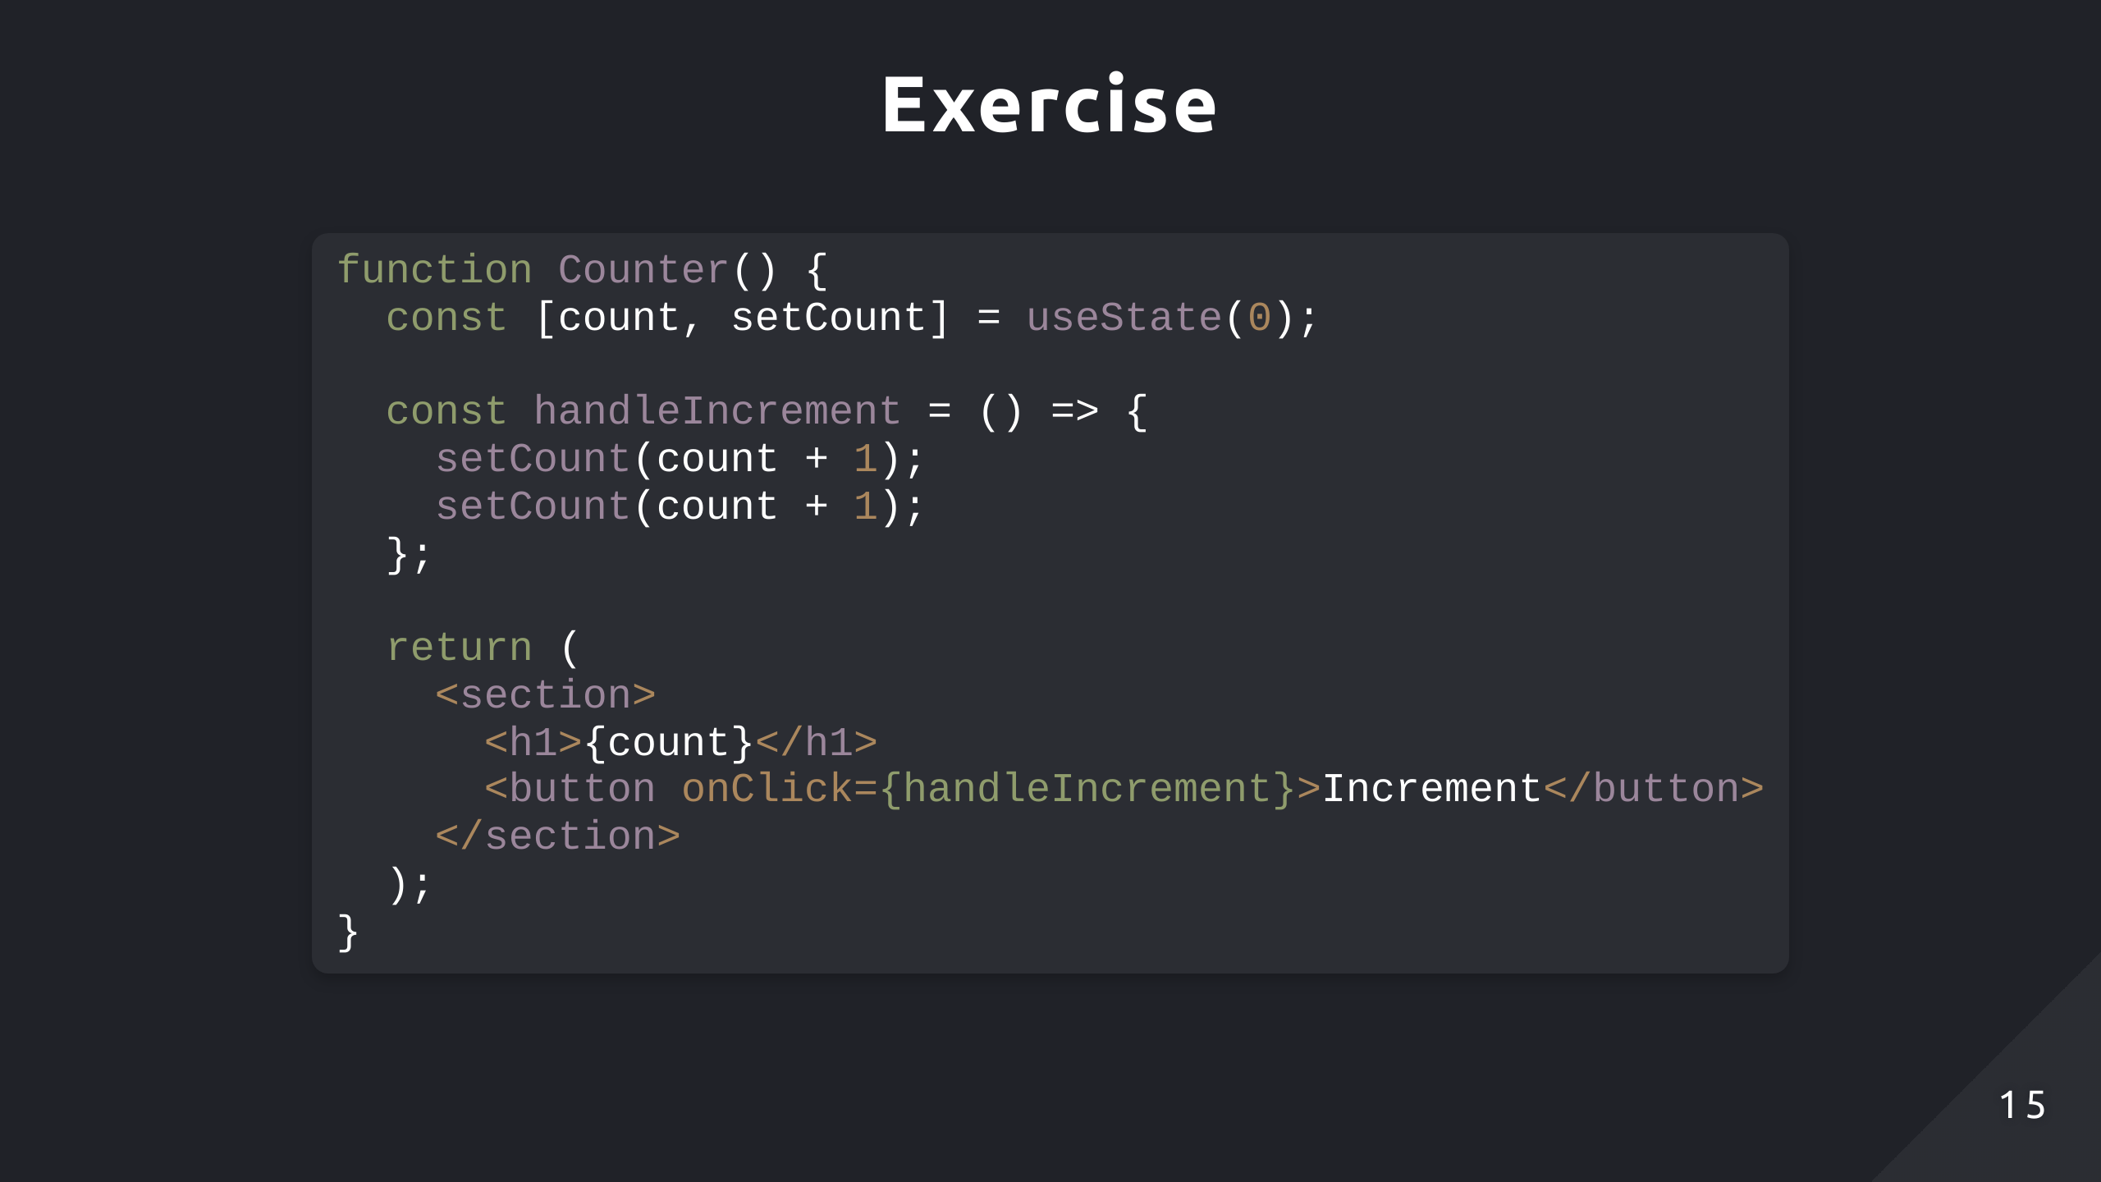
Notes:
So now I have a small exercise for you, can you describe what will happen with this code

Slide 16
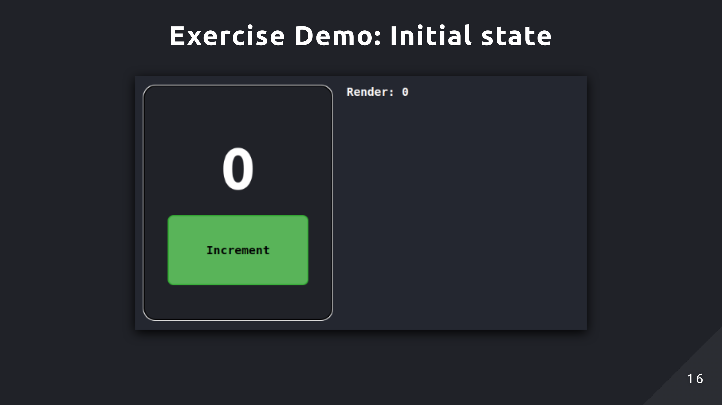

Slide 17
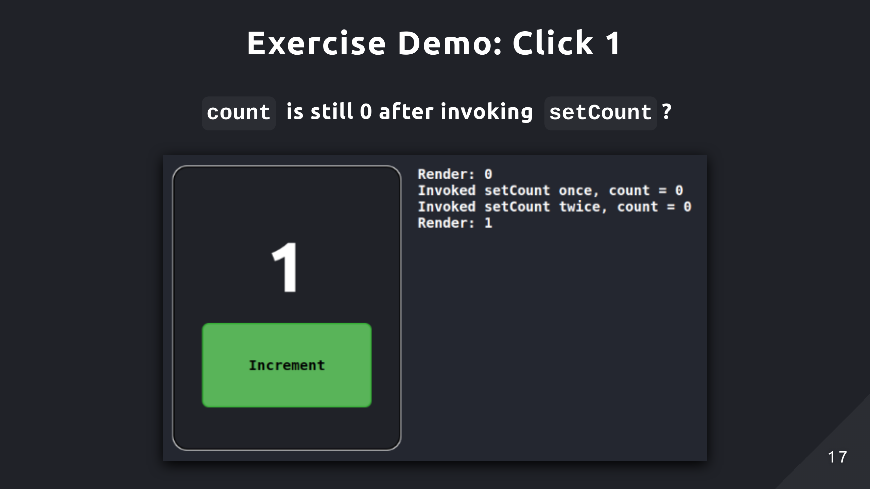
Notes:
So we click increment which invokes setCount twice but after both times, the count still remains 0 for some reason
Then when state updates and re-renders the component, it only shows 1

Slide 18
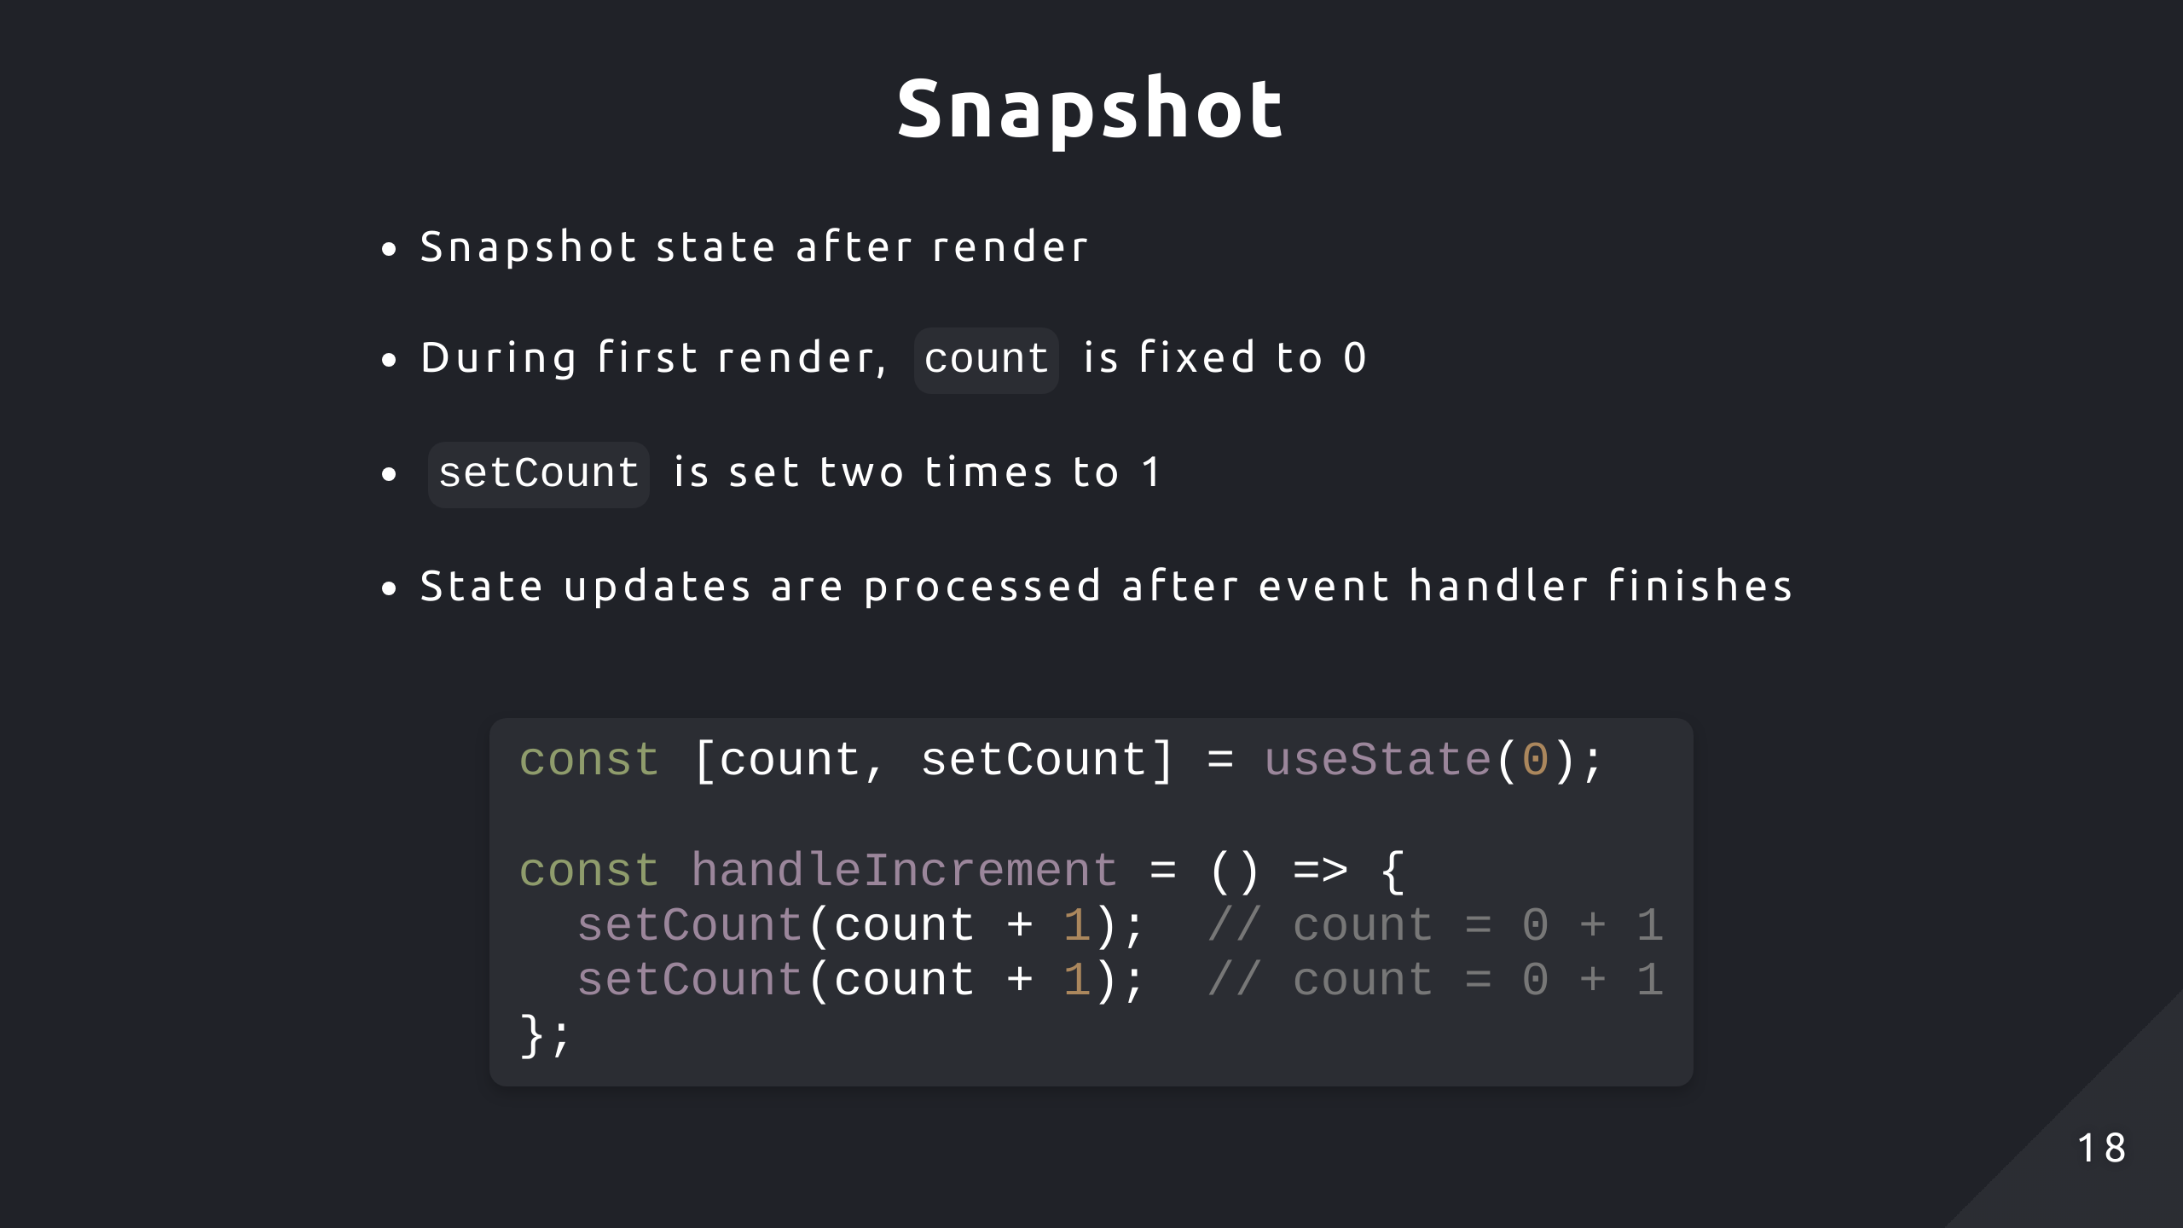
Notes:
This is due to React taking a snapshot of the UI after rendering
When setCount was called both times, it referenced the fixed value of 0 and performed the calculation 0 + 1 each time
But the state also isn’t updating after each call, that’s because the update is only done after all the code in the event handler completes

Slide 19
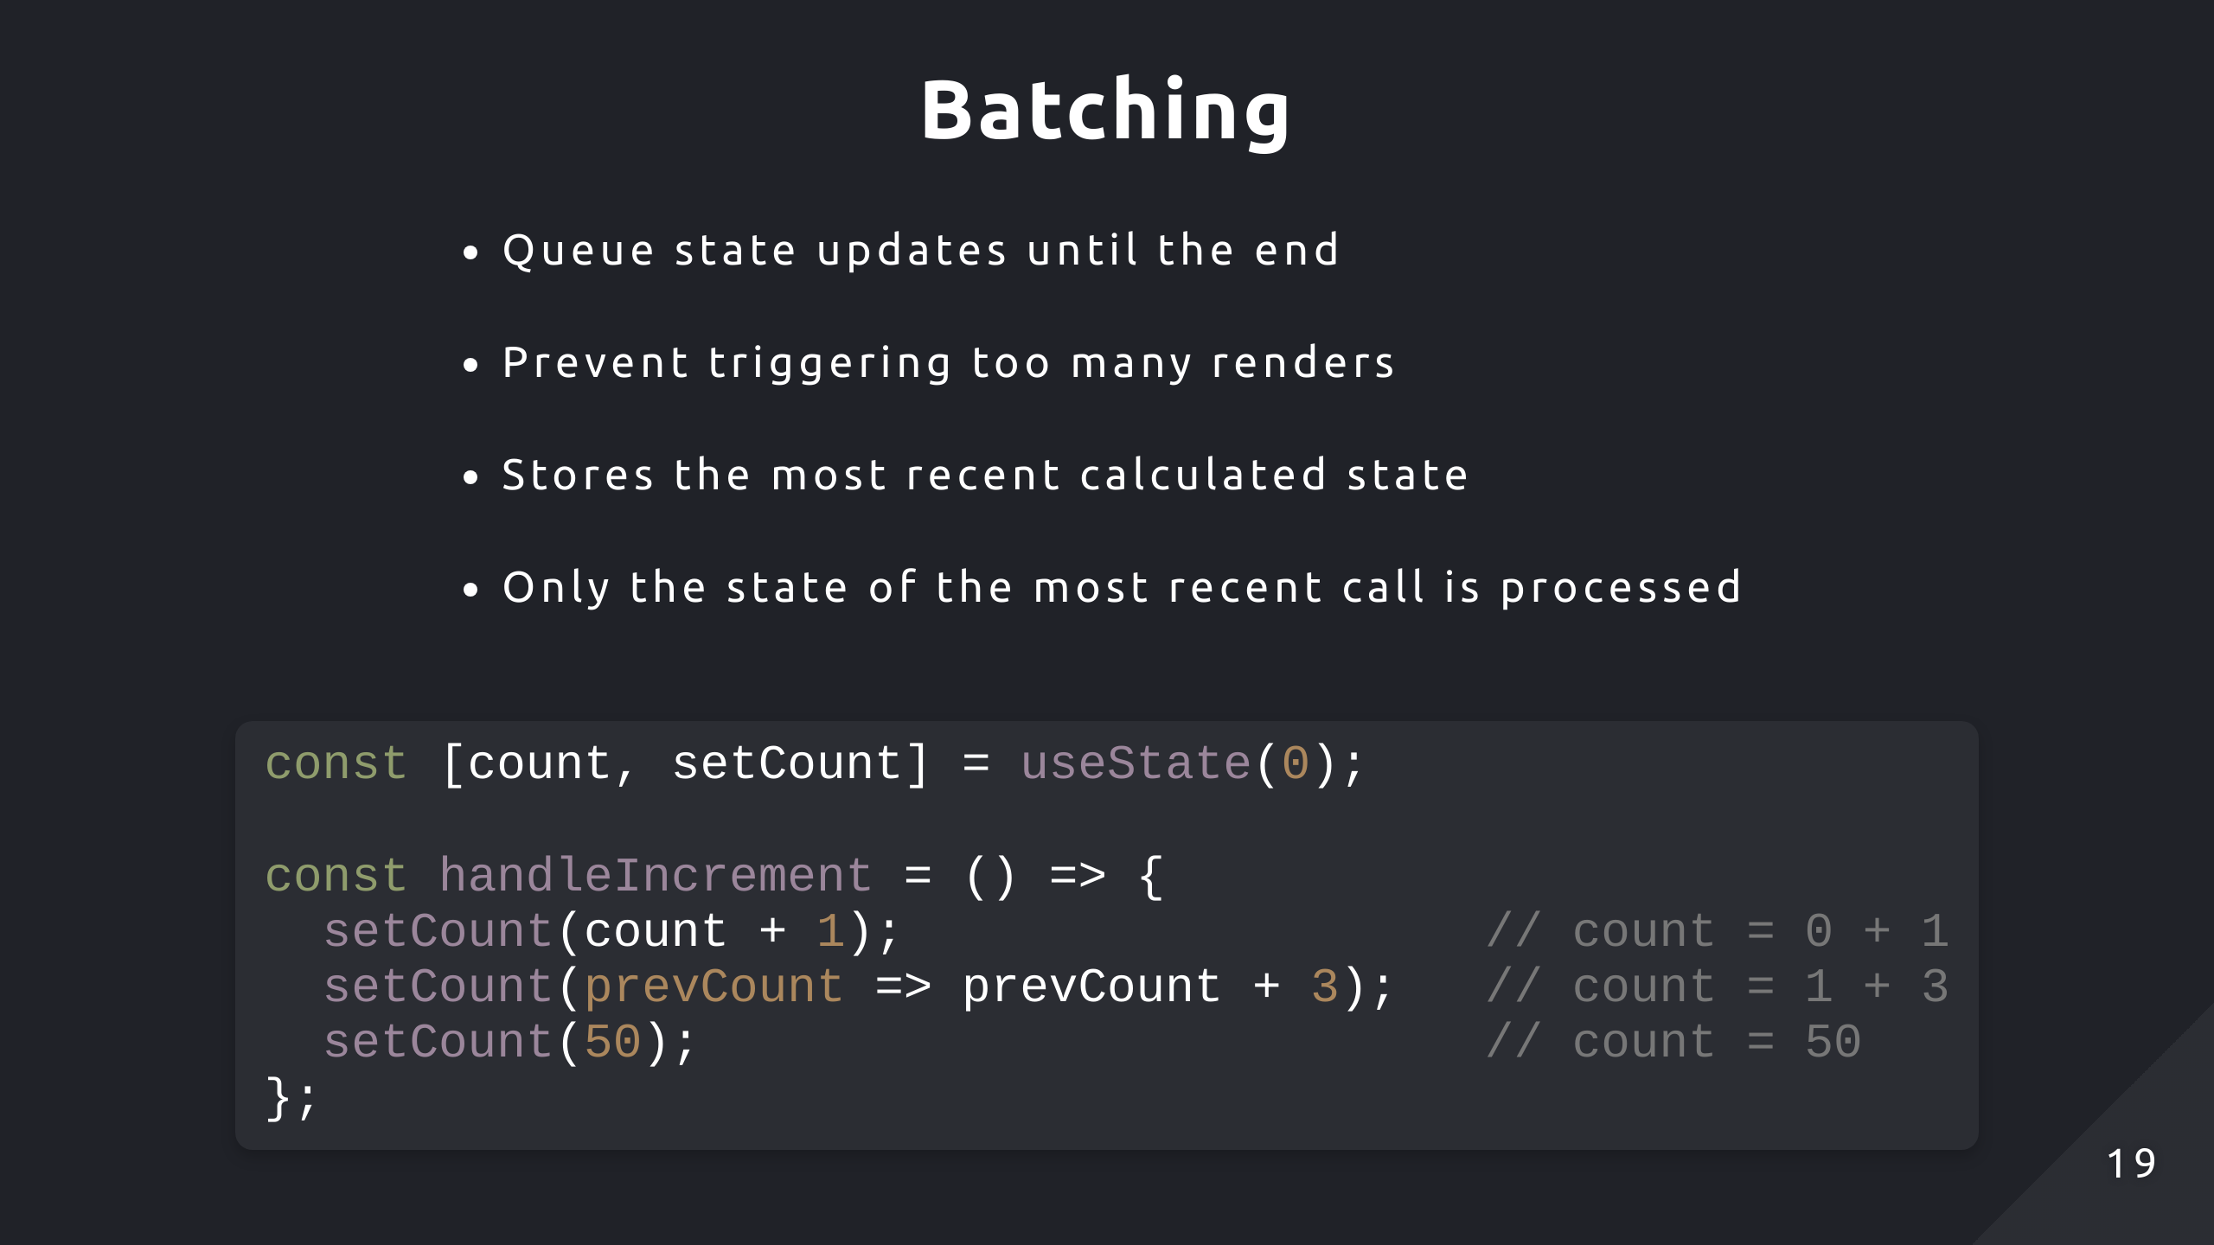
Notes:
When multiple calls to a setter function occur, a concept called batching is applied
It stores all the recent state updates after invoking each function but only uses the most recent change as the final update
Think of it like a waiter taking your order, they don’t go back to the kitchen after you mention 1 dish. They wait until you complete your order and make changes to it first

Slide 20
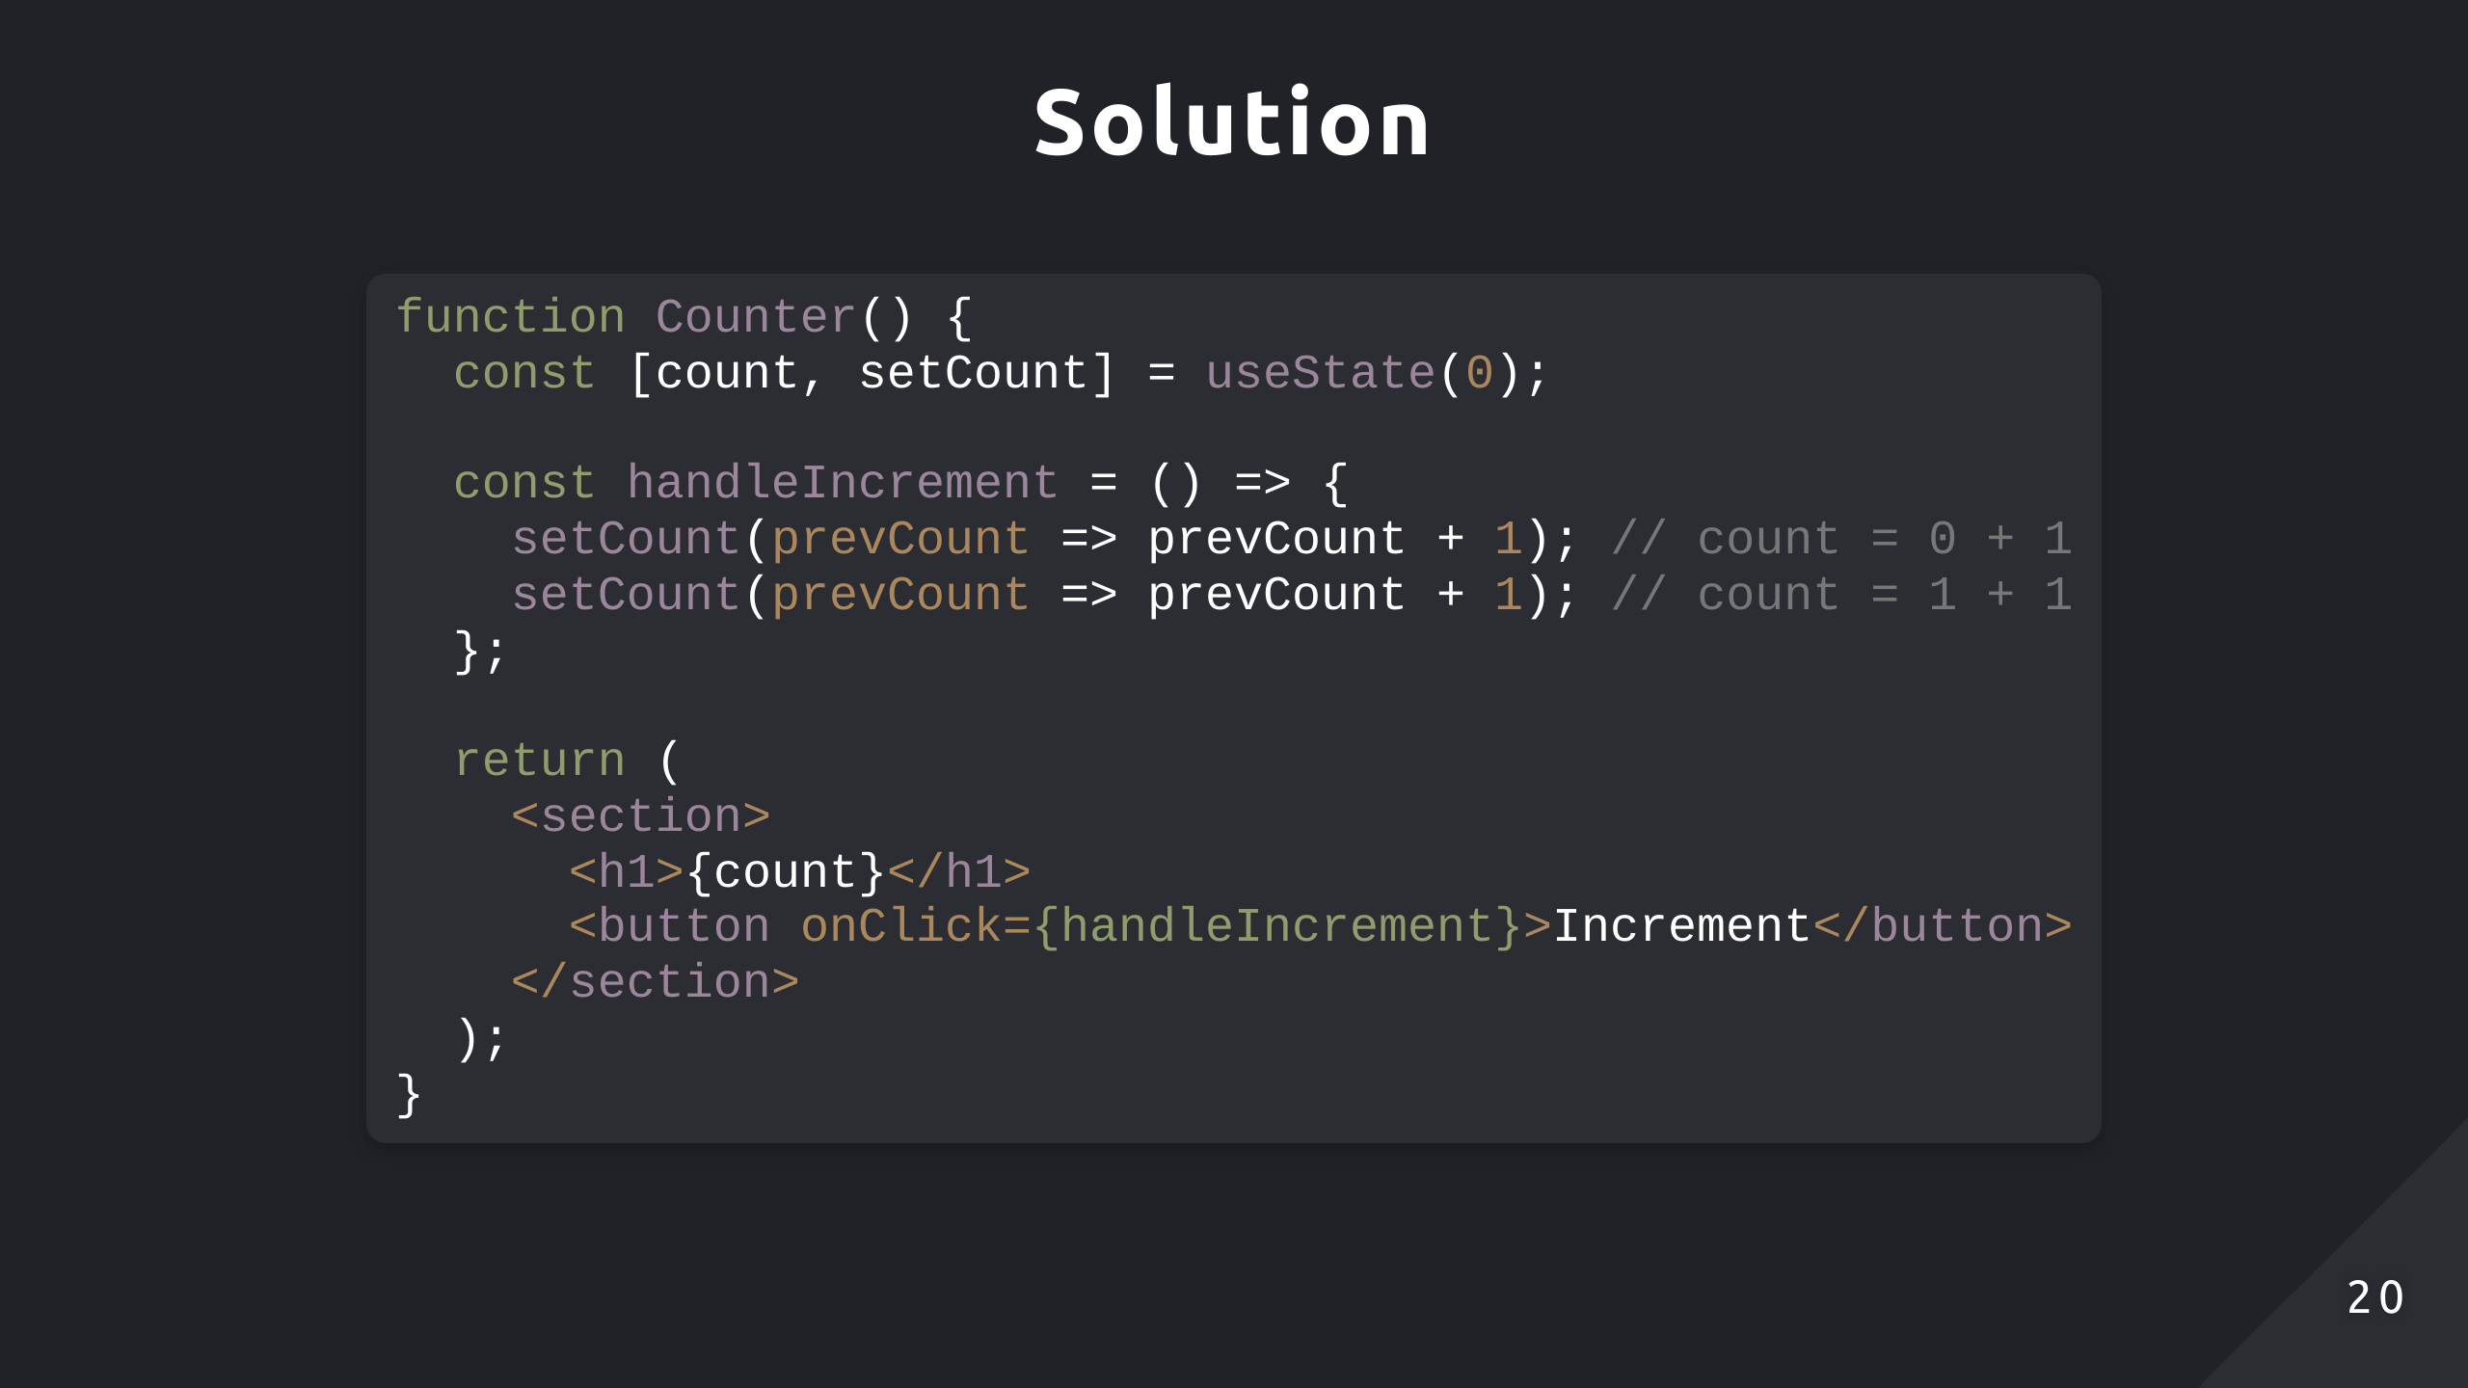

Slide 21
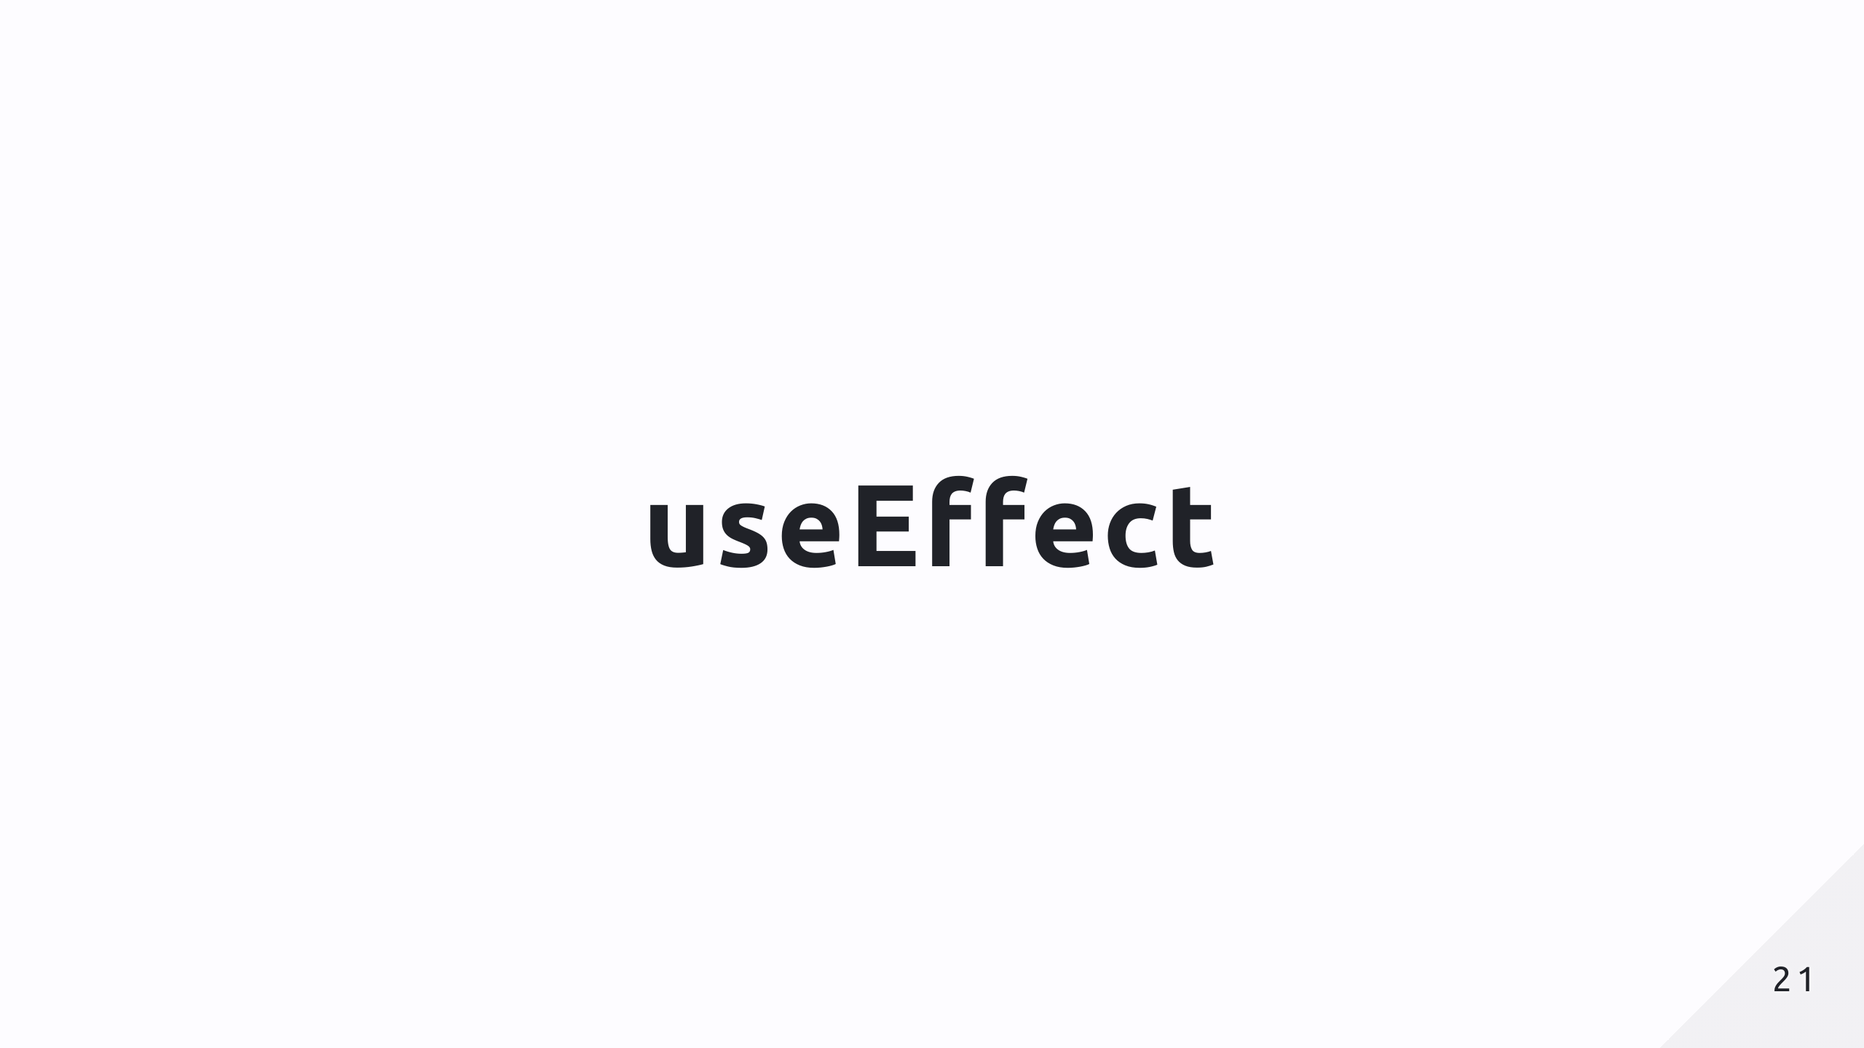

Slide 22
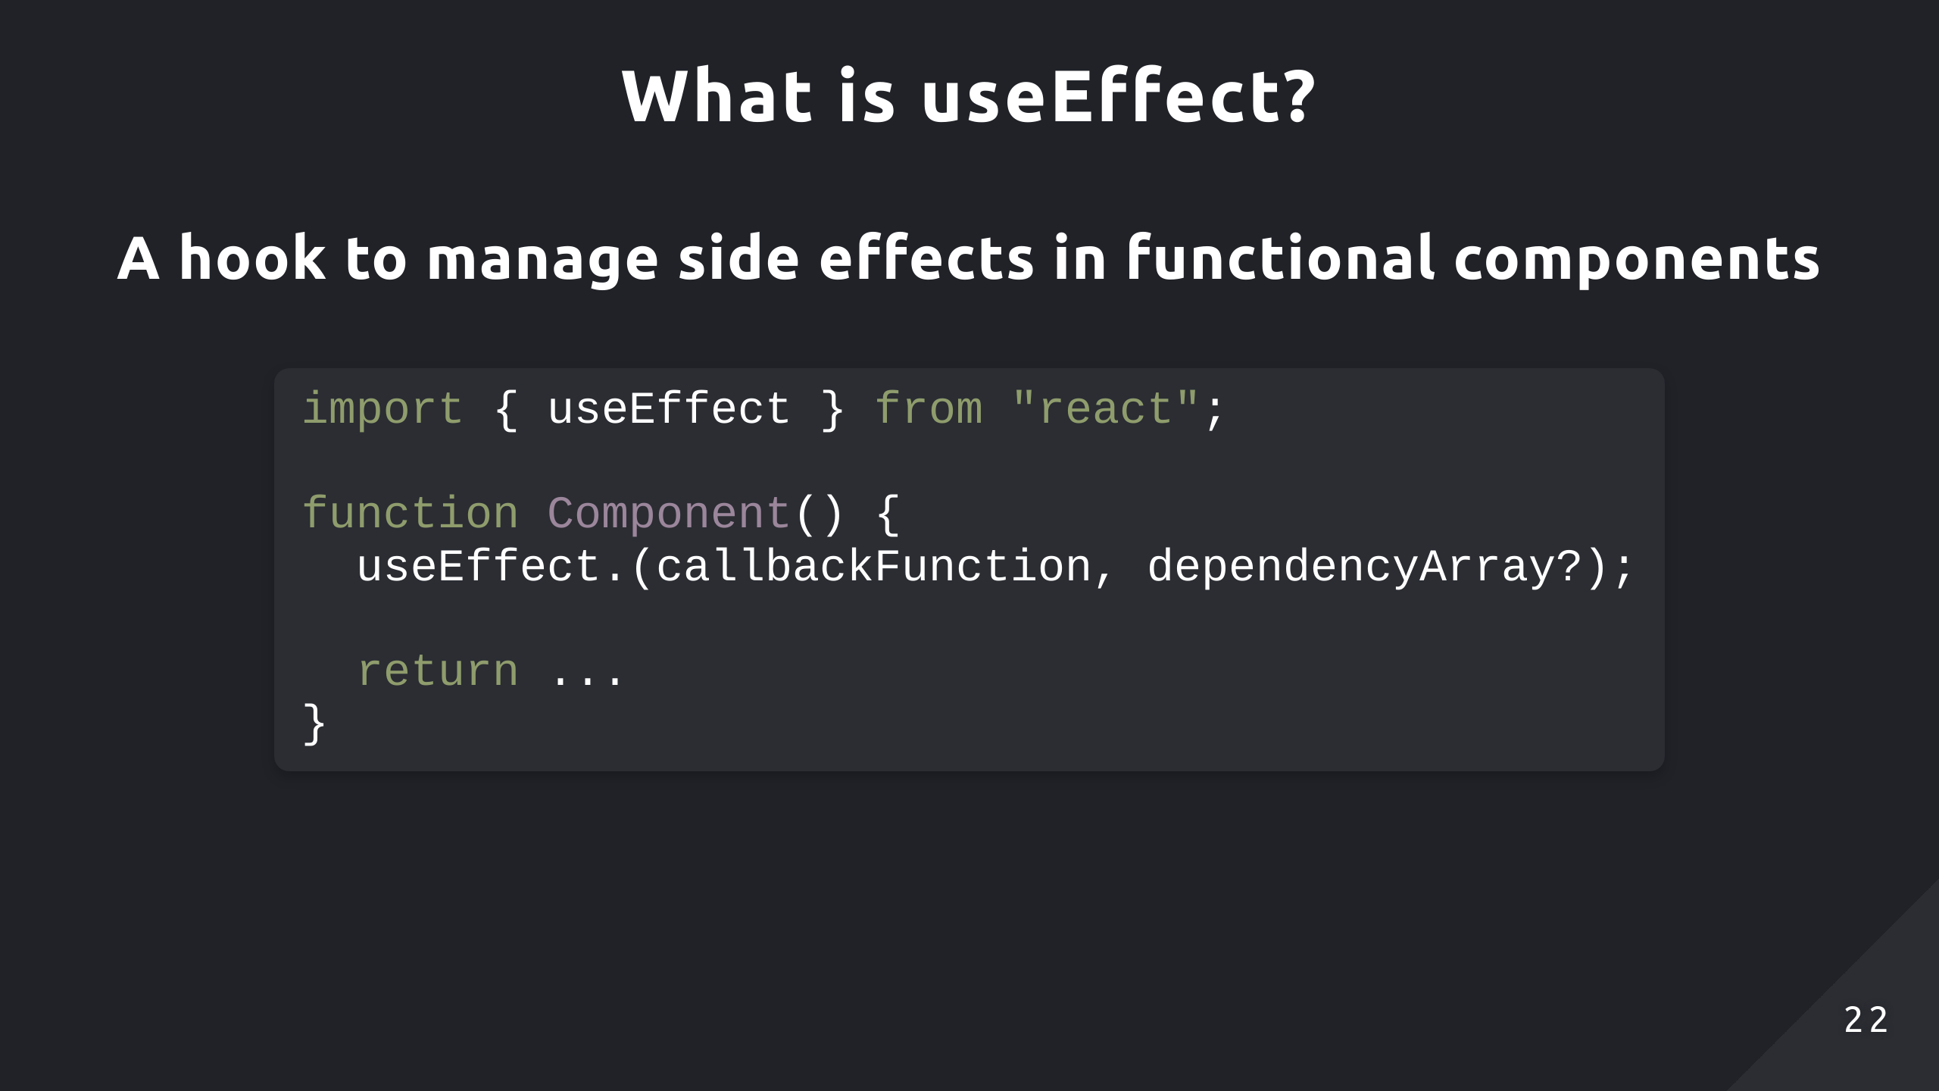

Slide 23
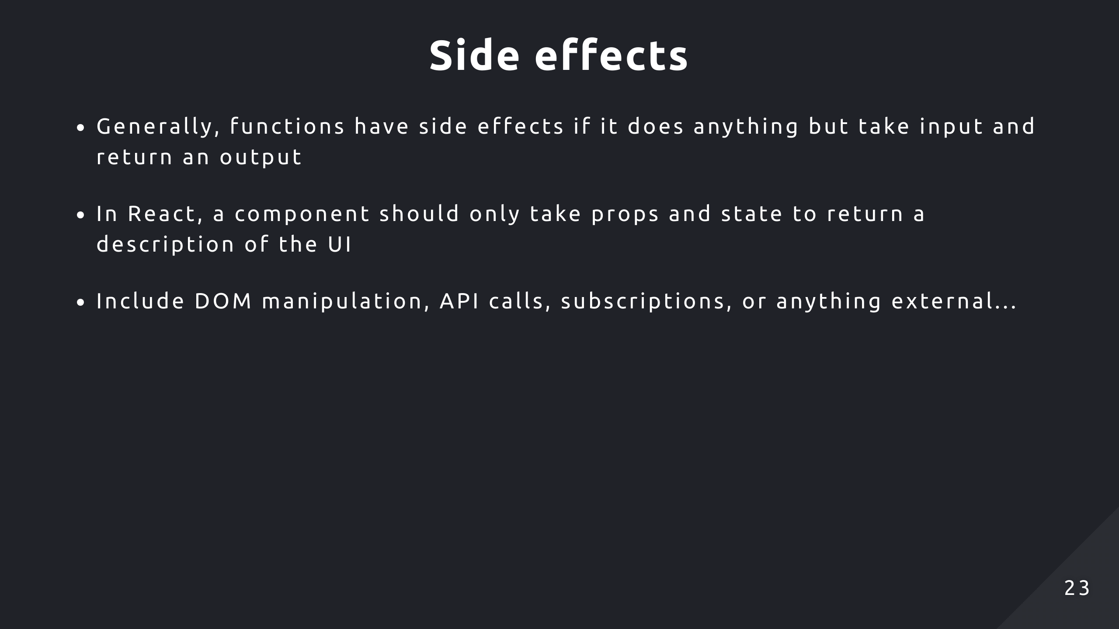

Slide 24
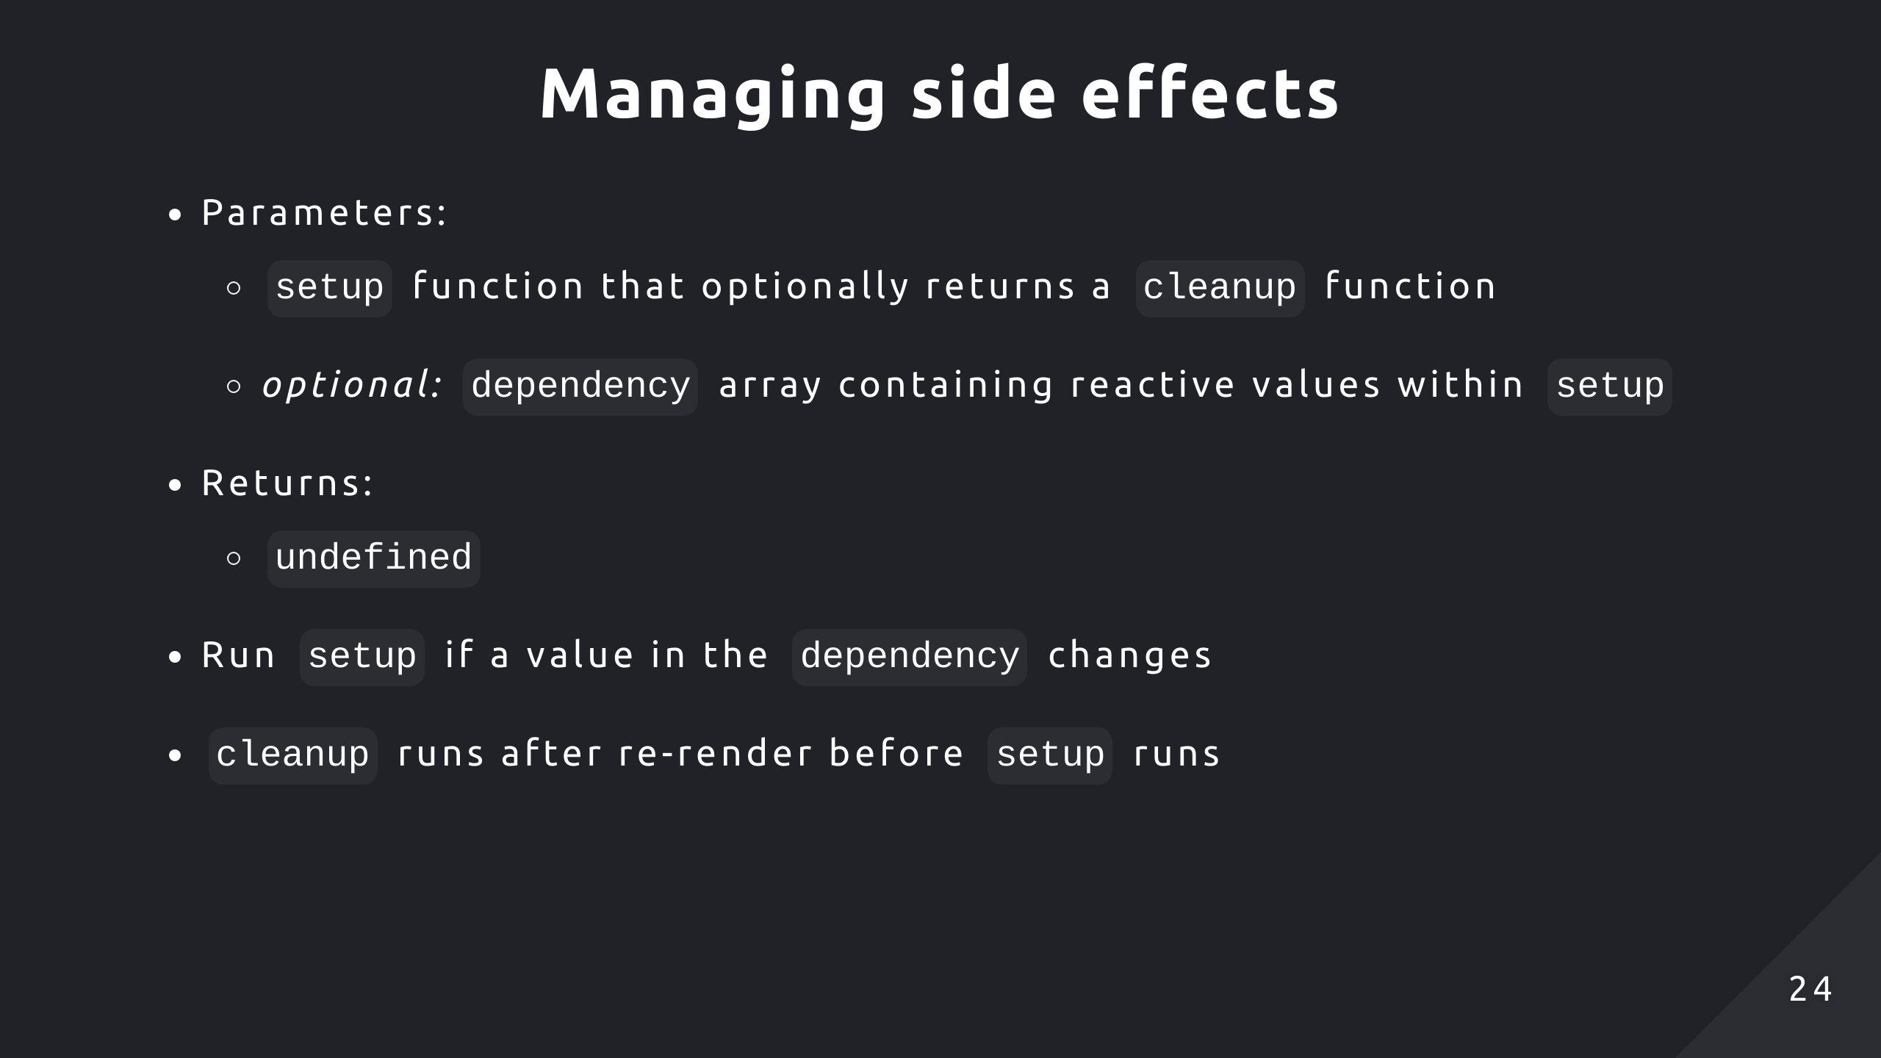
Notes:
It will take a setup function which will have the logic to run a side effect
The setup function is invoked whenever some dependent variable being tracked is changed

Slide 25
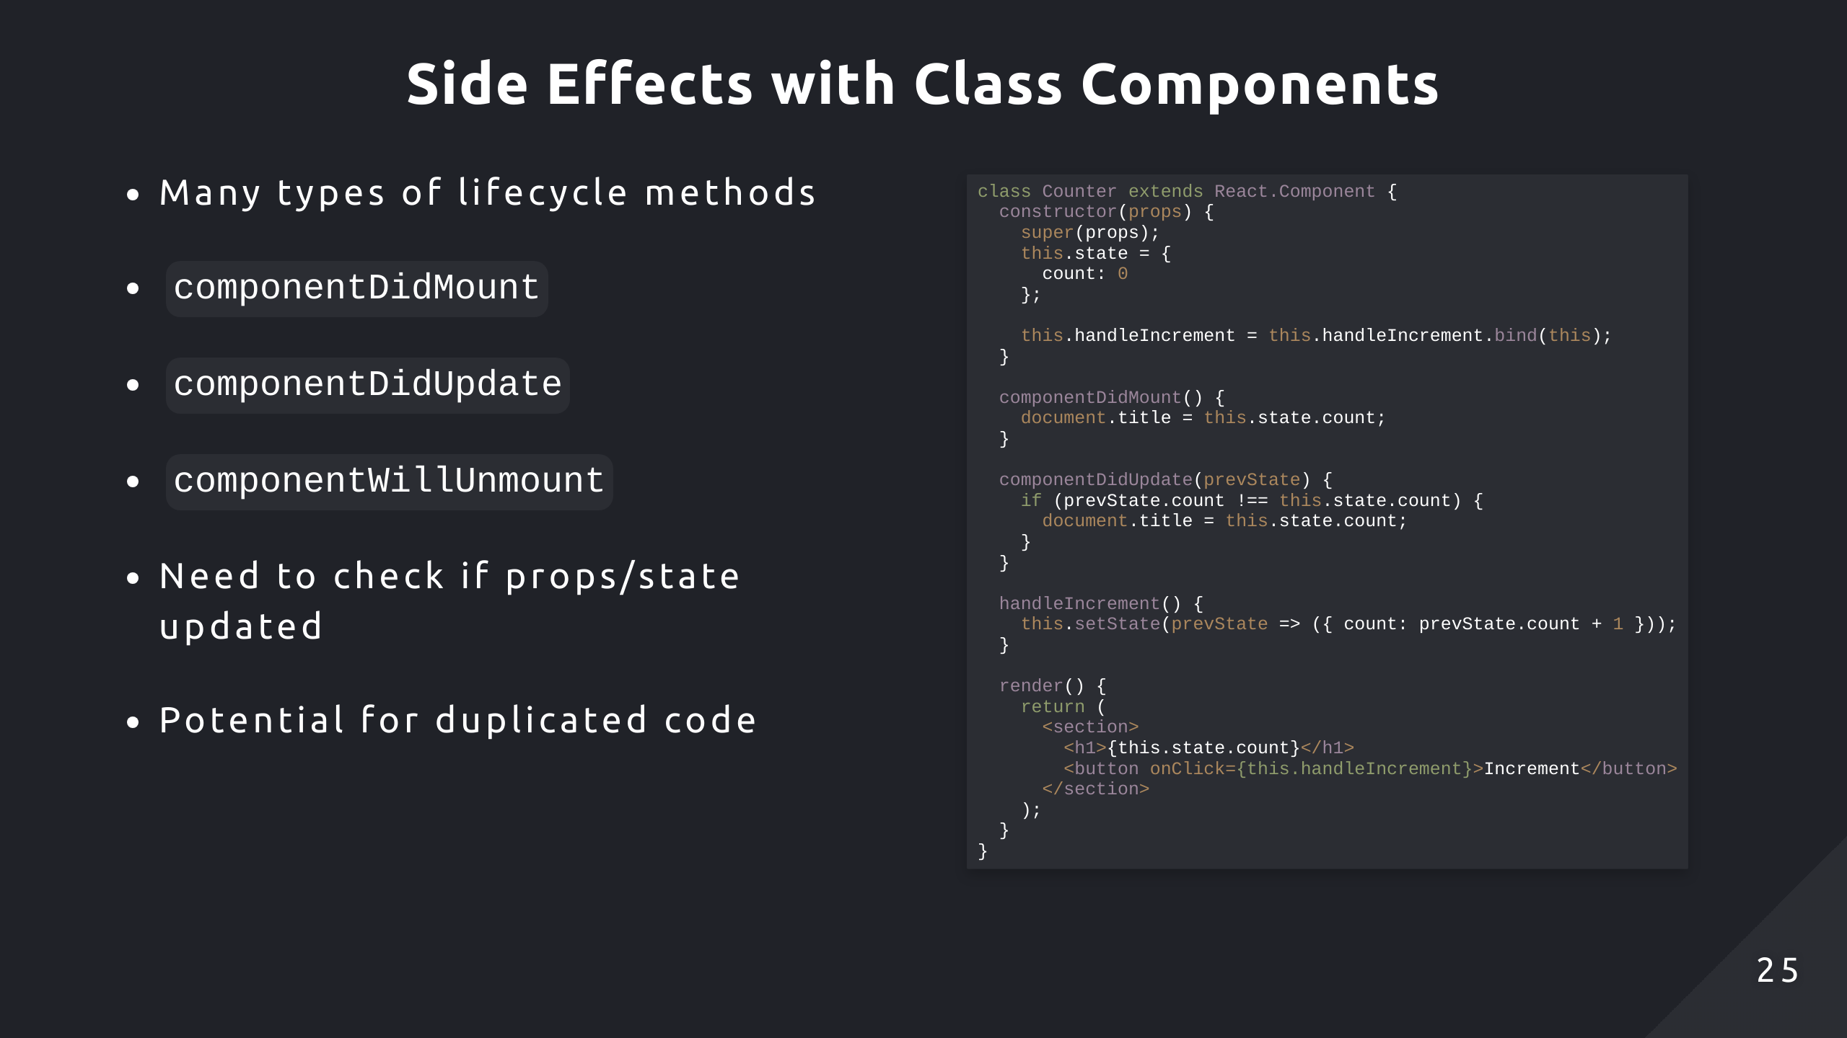
Notes:
I’ve extended the app to also update the title of the tab to the current count
So we have our first lifecycle method componentDidMount which is run once after mounting
Then for any re-renders caused by the counter updating, componentDidUpdate will run and update the tab title if the state is changed

Slide 26
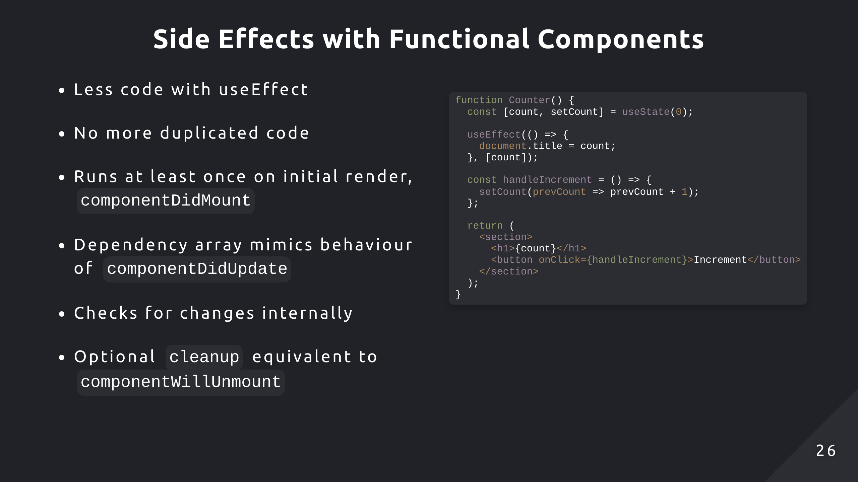
Notes:
For the functional component, we don’t have the lifecycle methods anymore. UseEffect takes in a callback function to run our side effect
You can think of useEffect as trying to mimic the behaviour of the 3 lifecycle methods

Slide 27
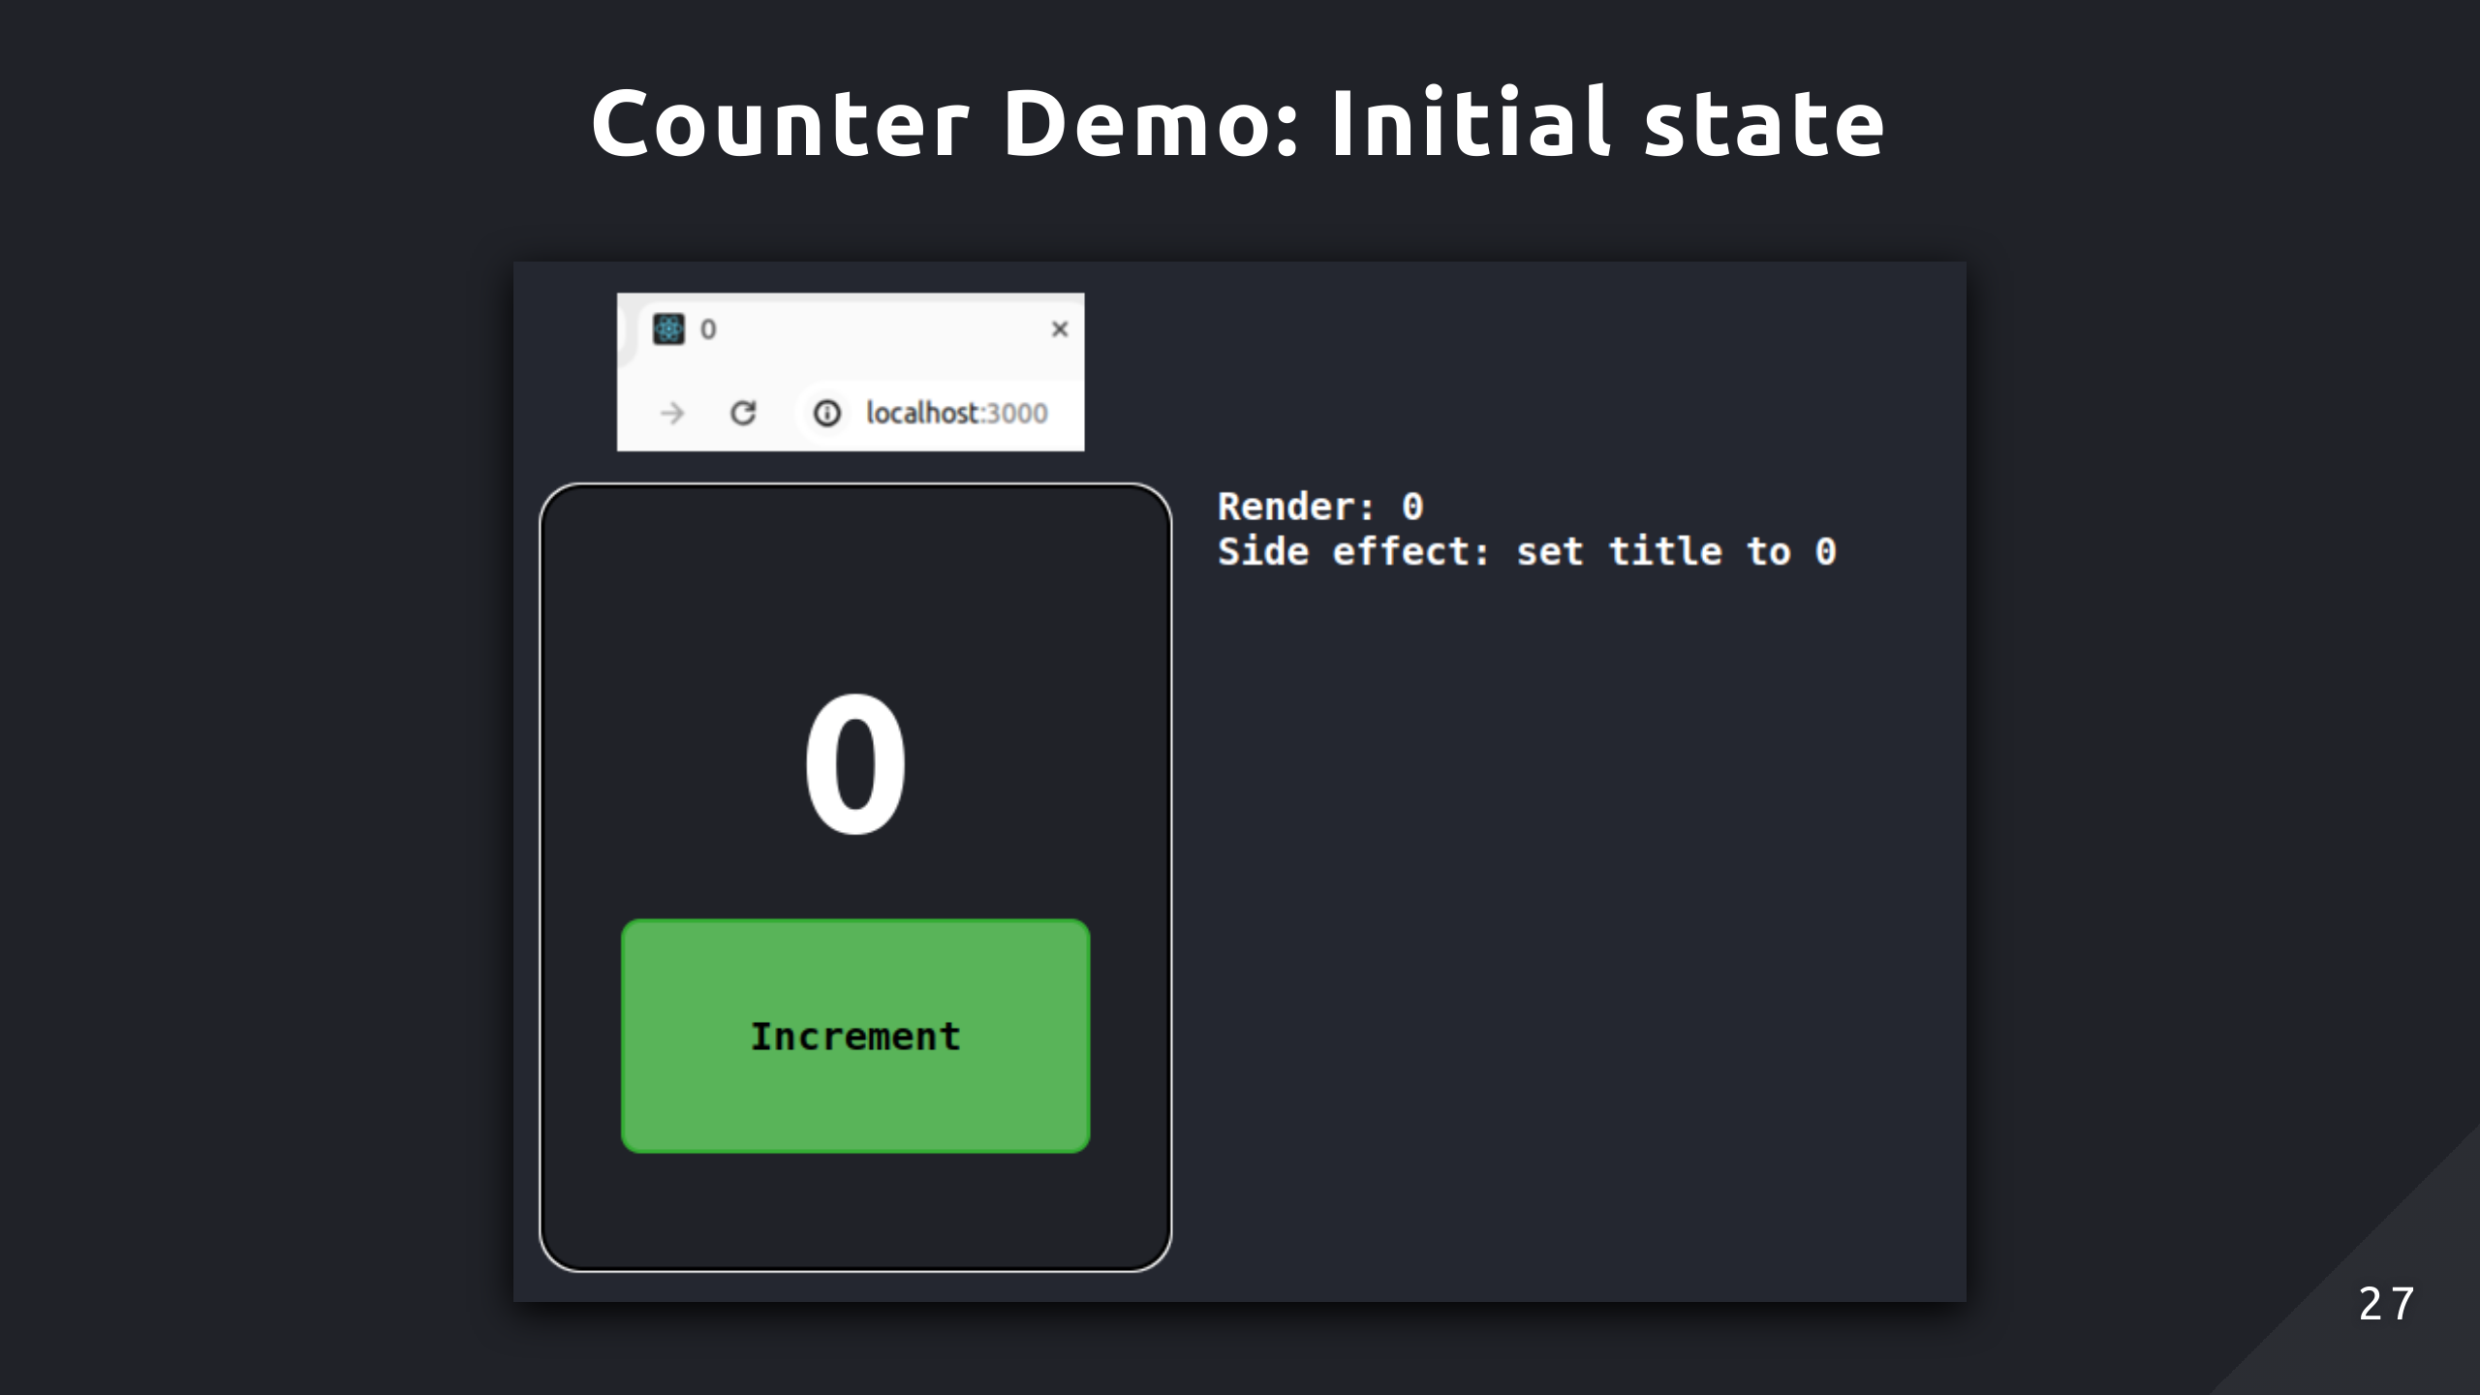
Notes:
So here the initial render occurs and the side effect is run after the render, updating the tab title

Slide 28
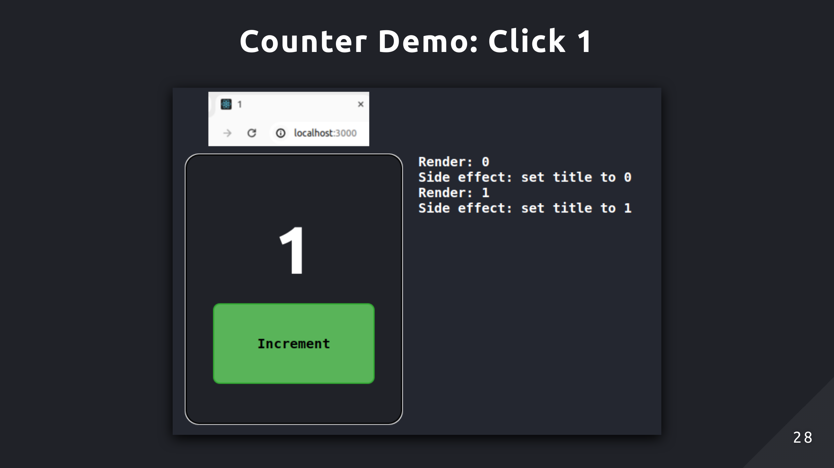
Notes:
When the button is clicked, the state updates and triggers a re-render. Now it displays 1, and React notices the count variable changed in the dependency array. Now it updates the title by rerunning the side effect

Slide 29
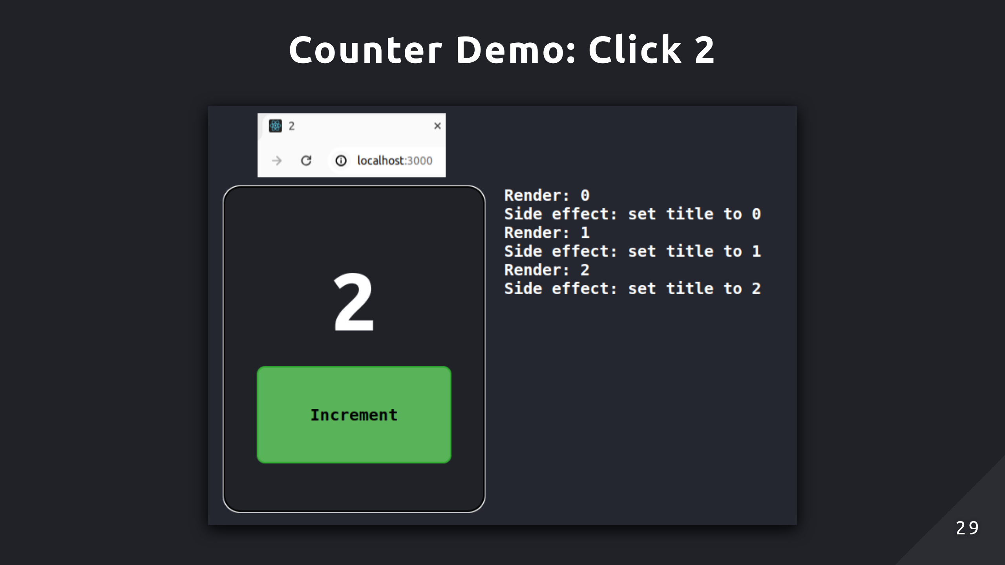

Slide 30
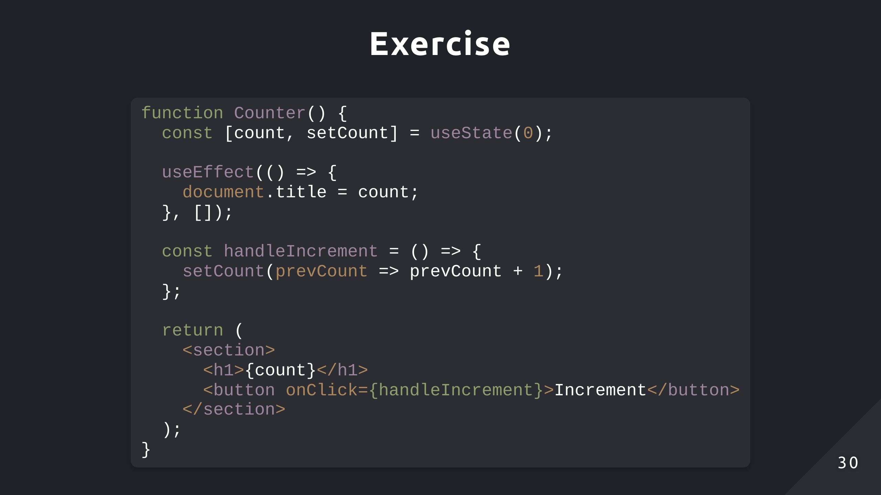
Notes:
Similar to before, I want you to describe what this code will do. The only thing is the useEffect section

Slide 31


Slide 32
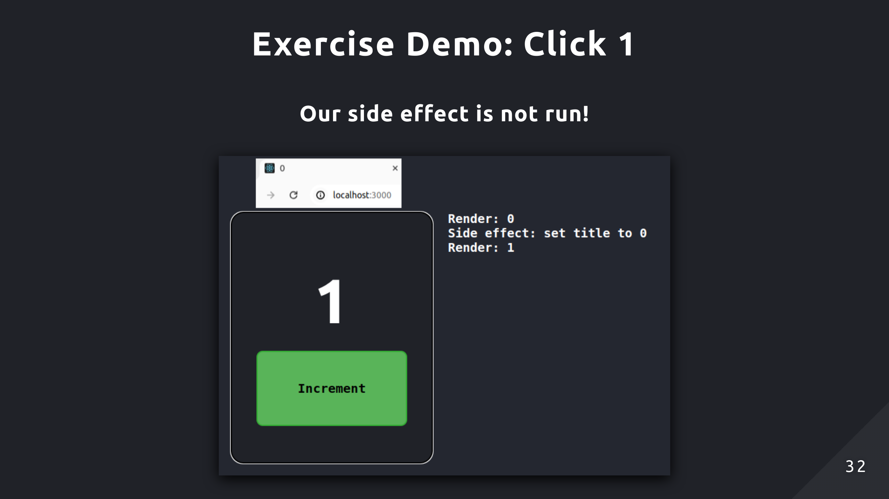
Notes:
Here you will notice the side effect is not run, and the title is not updated. This is because we passed an empty dependency array, so React thinks there’s no reason to run the side effect because it there’s no dependent variable that can be changed

Slide 33
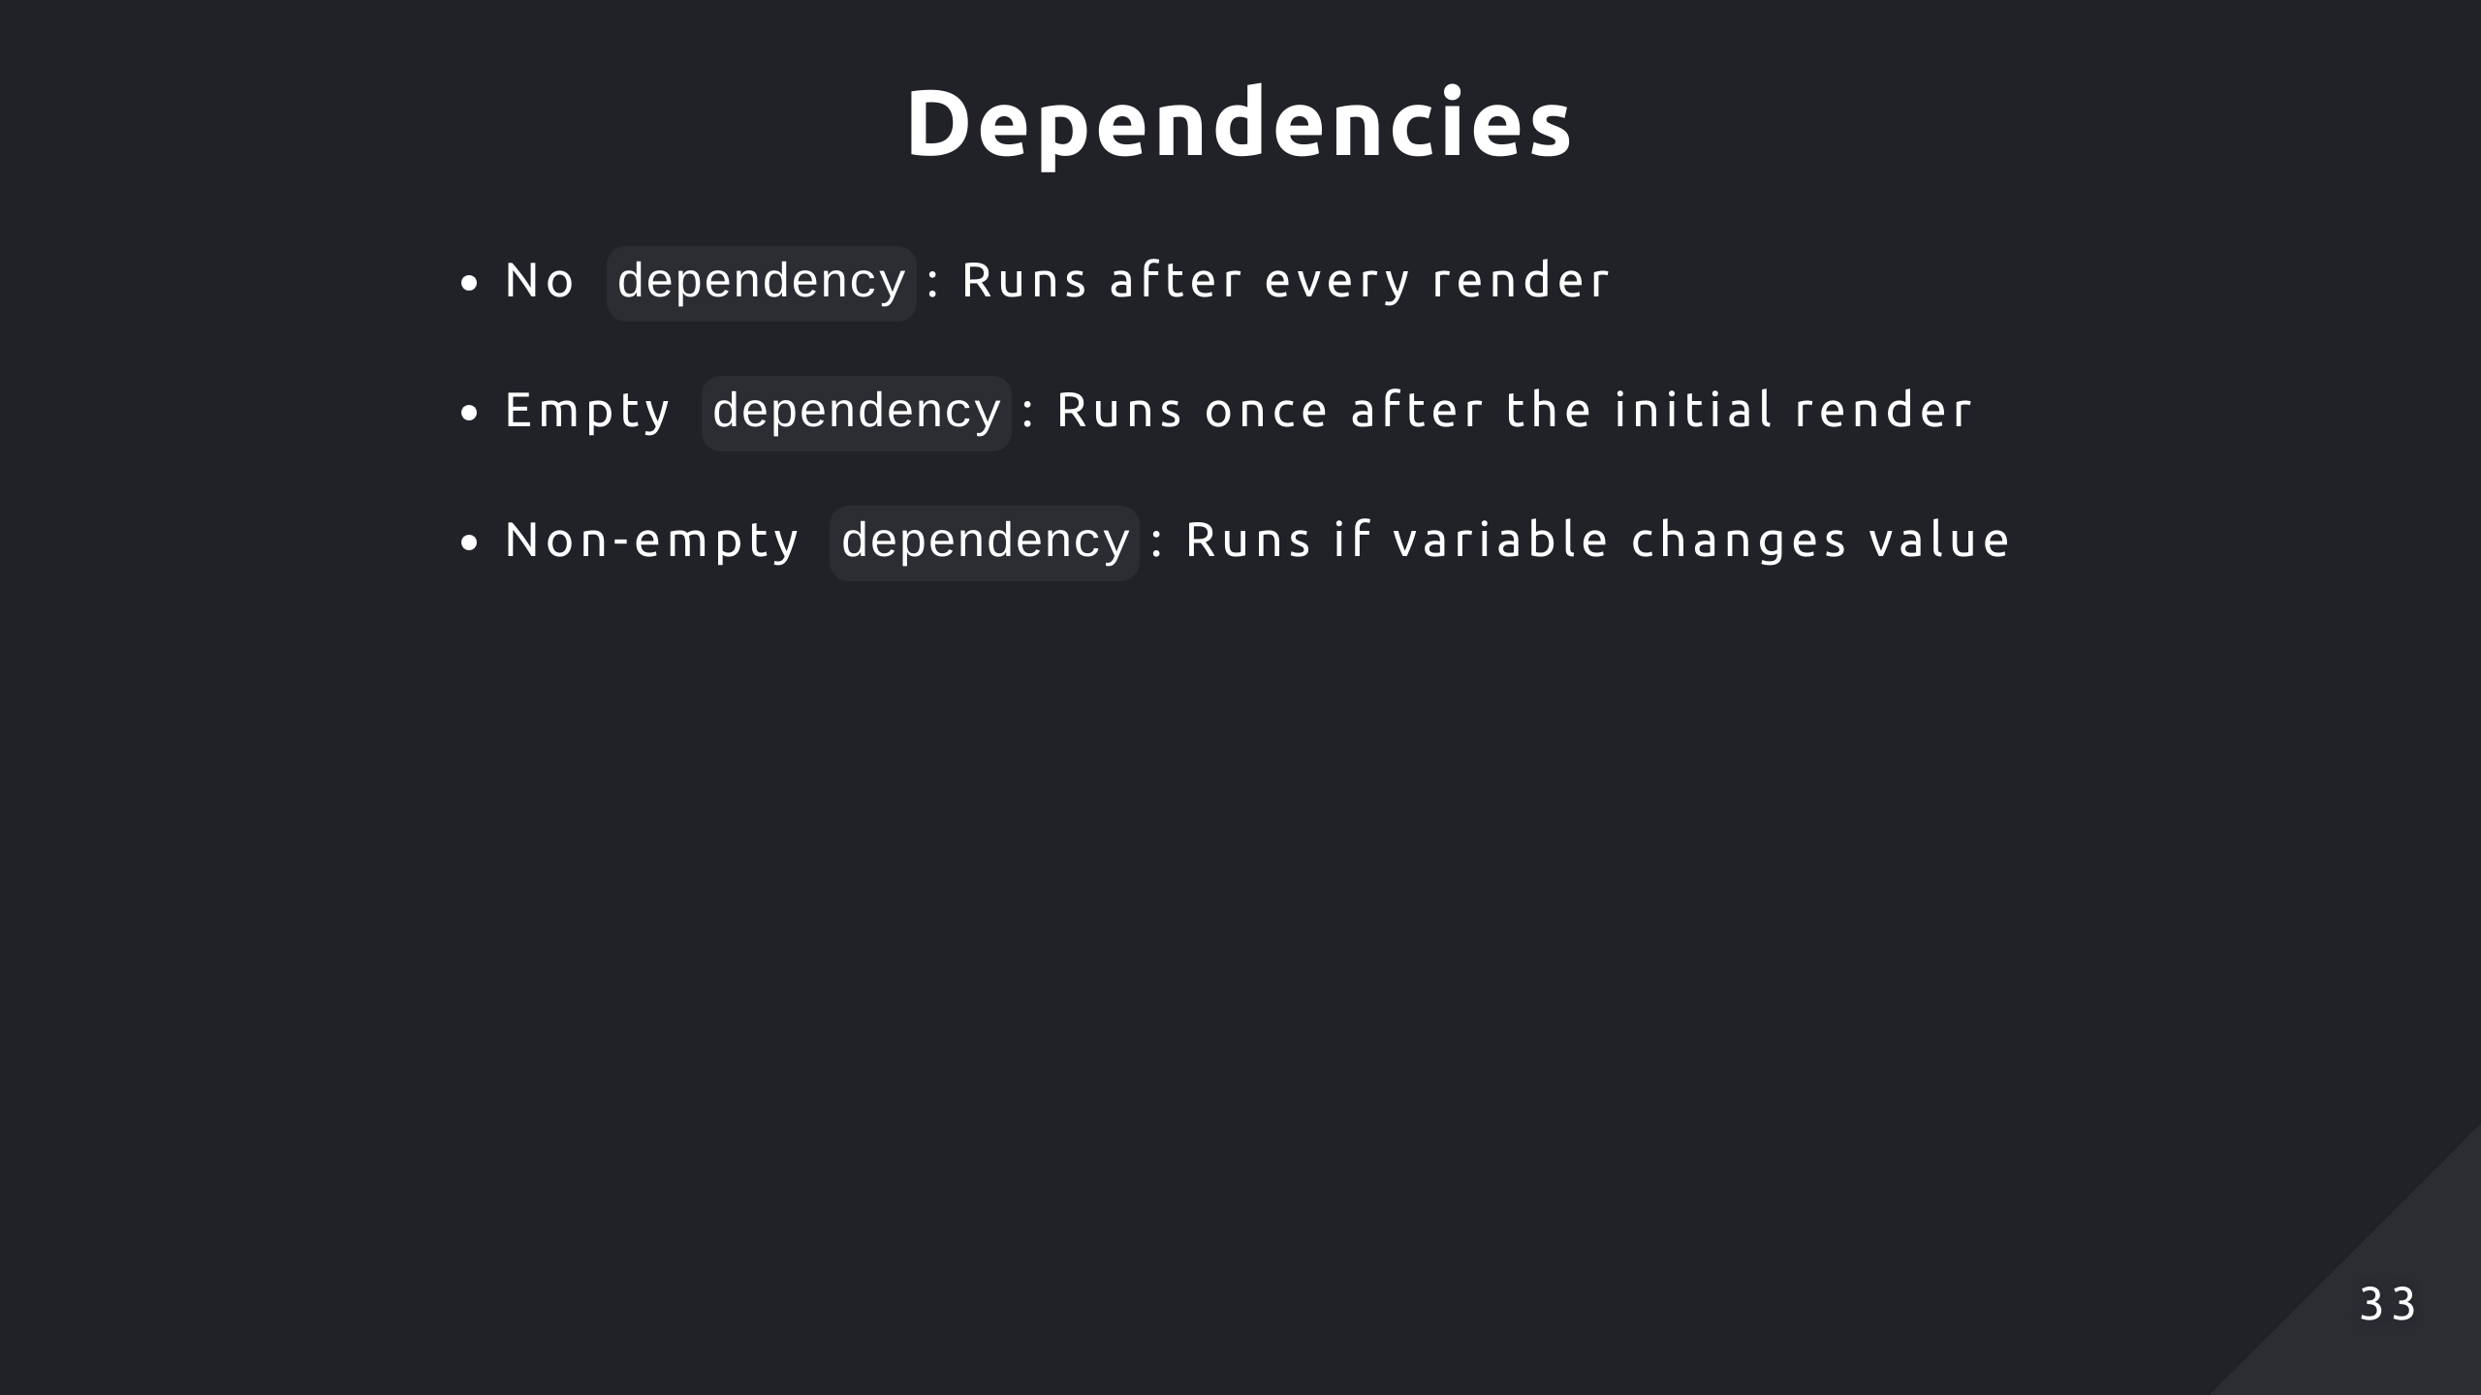
Notes:
We can summarise the behaviour of the dependency array like so

Slide 34
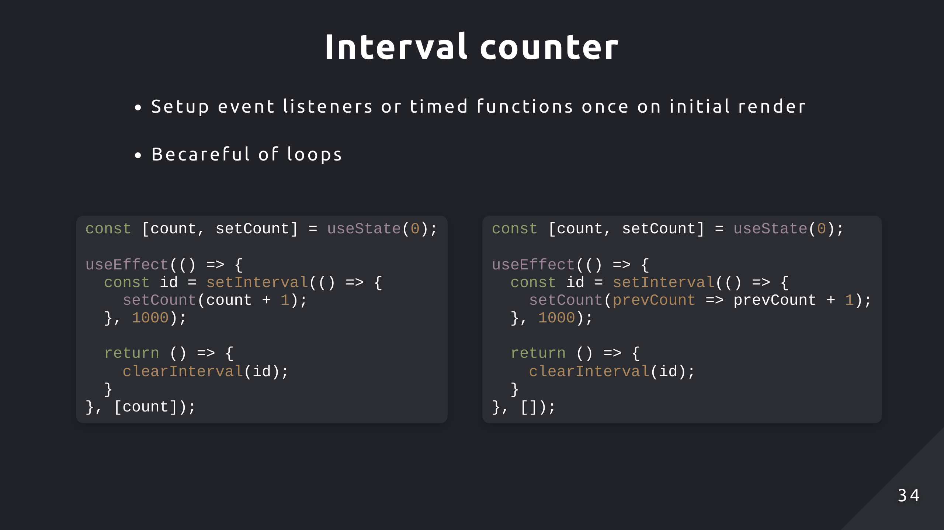
Notes:
I’ll go through a couple examples of times when you would use useEffect
Here we have a counter that increments every second by using a timer function
But you will notice that since count is a dependent variable, whenever setInterval invokes the callback.
It will infinitely clear the interval and reconstruct it

Slide 35
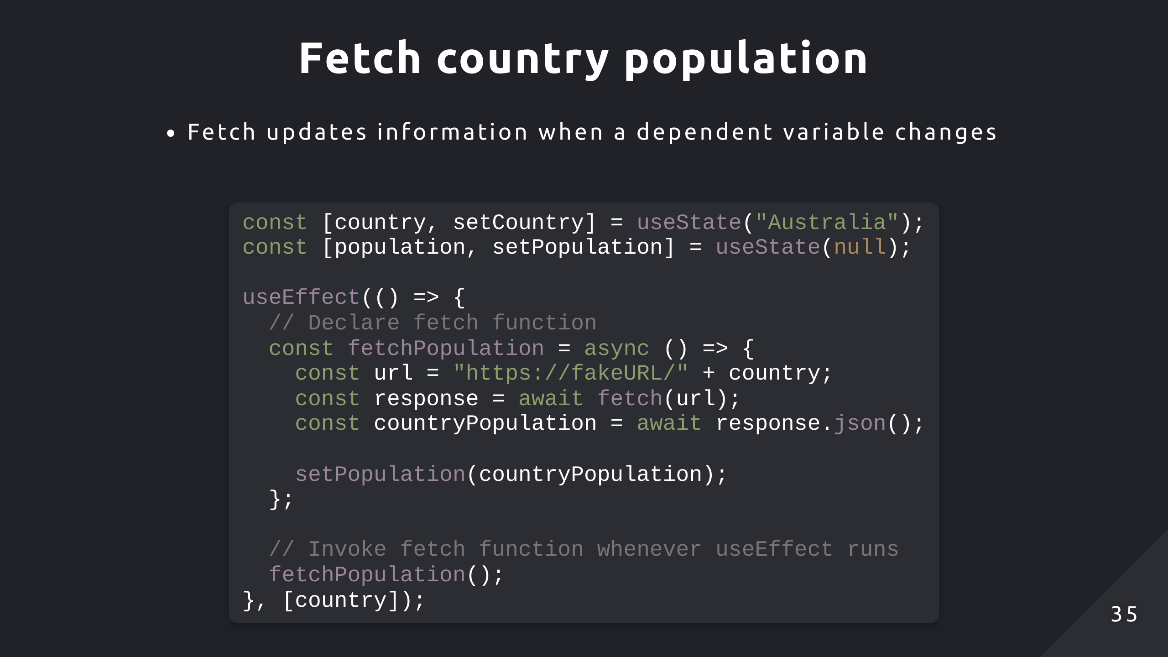
Notes:
And here’s an example where you might want to update some information based off some state change

Slide 36
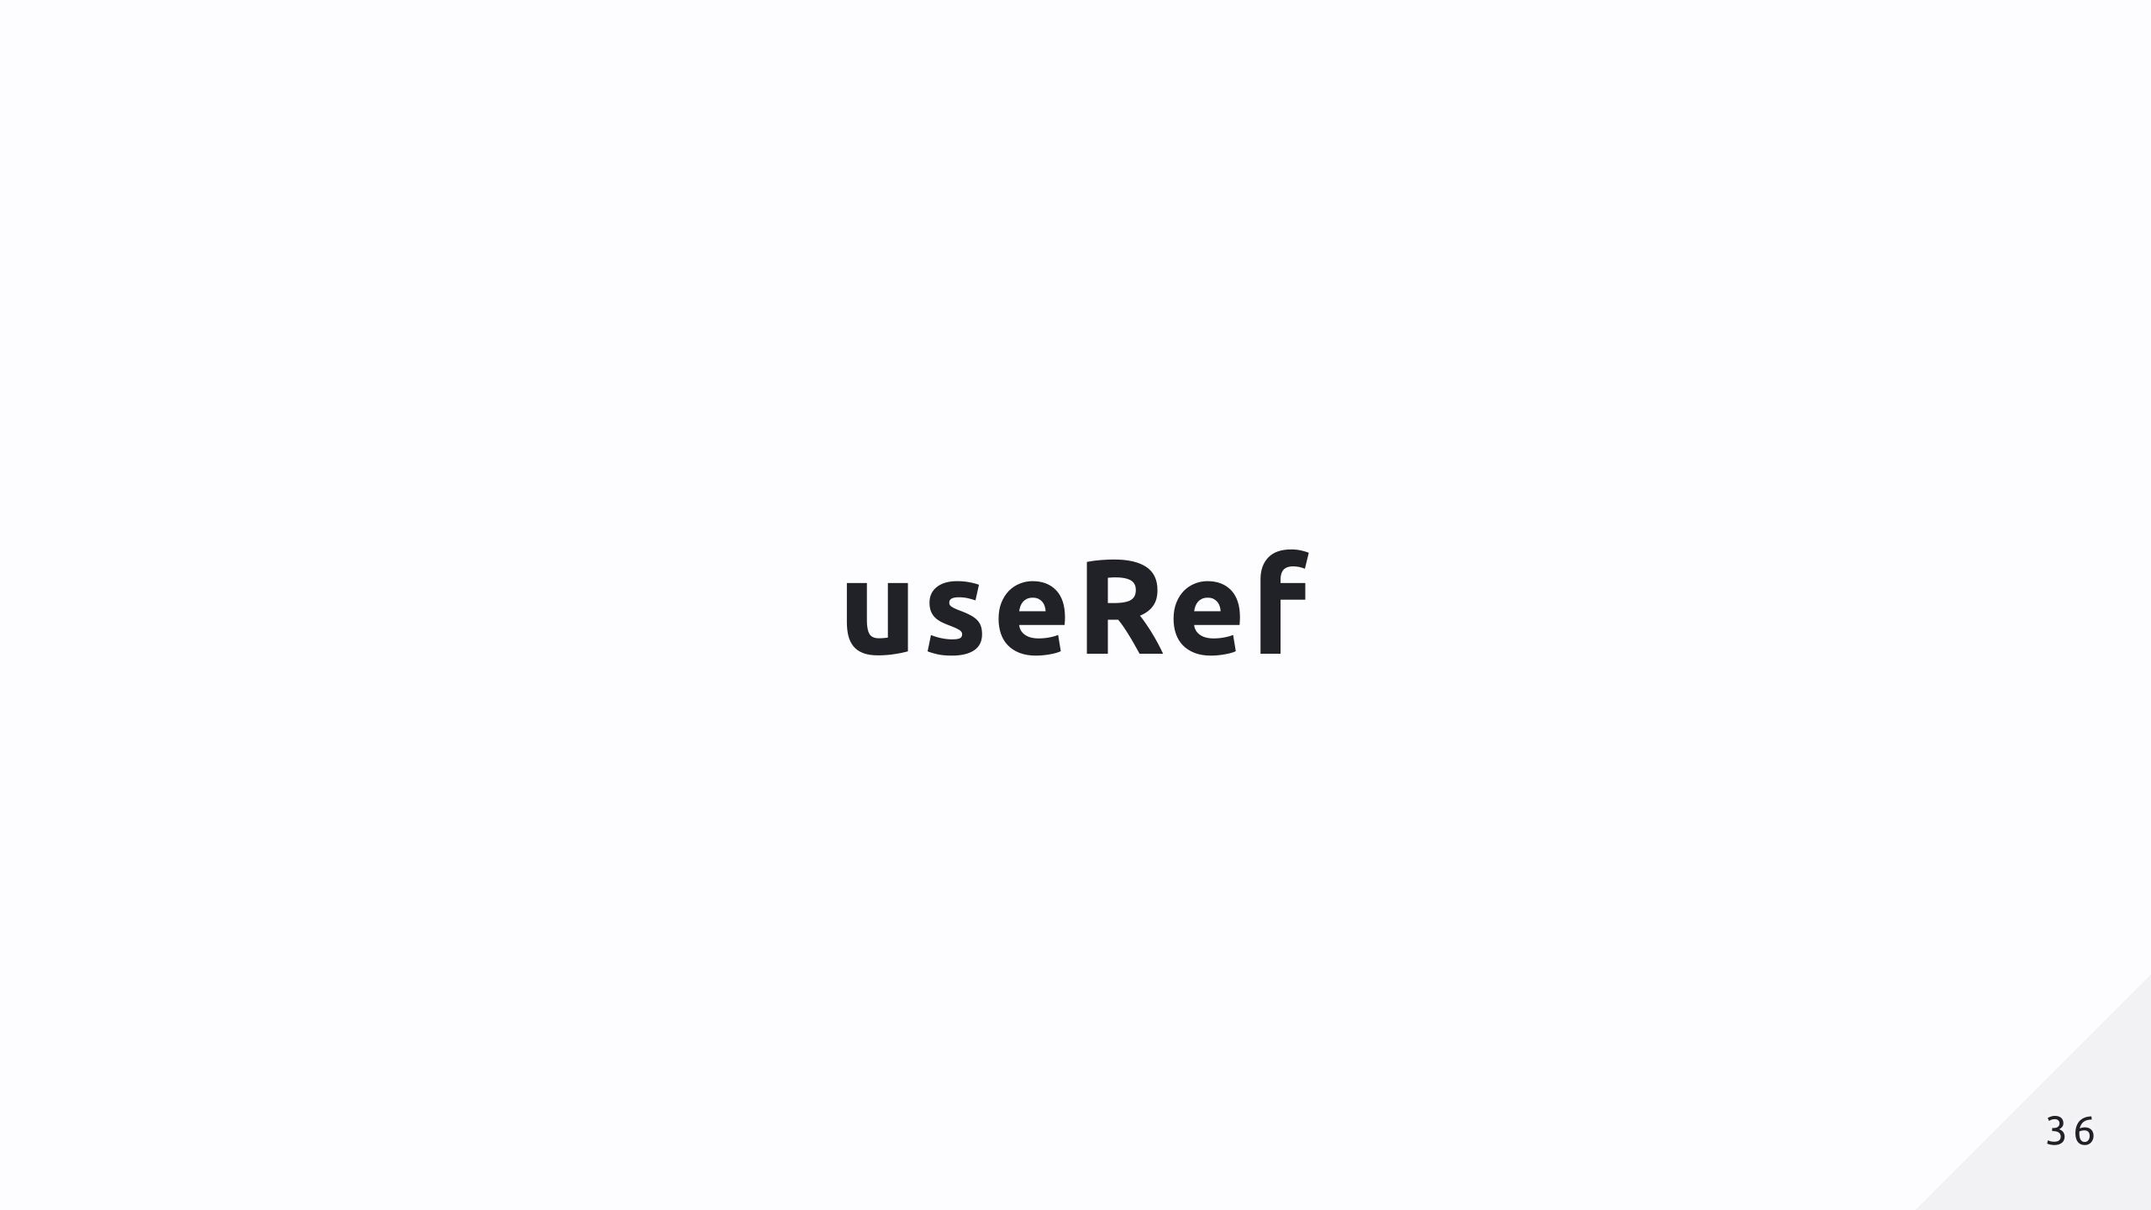

Slide 37
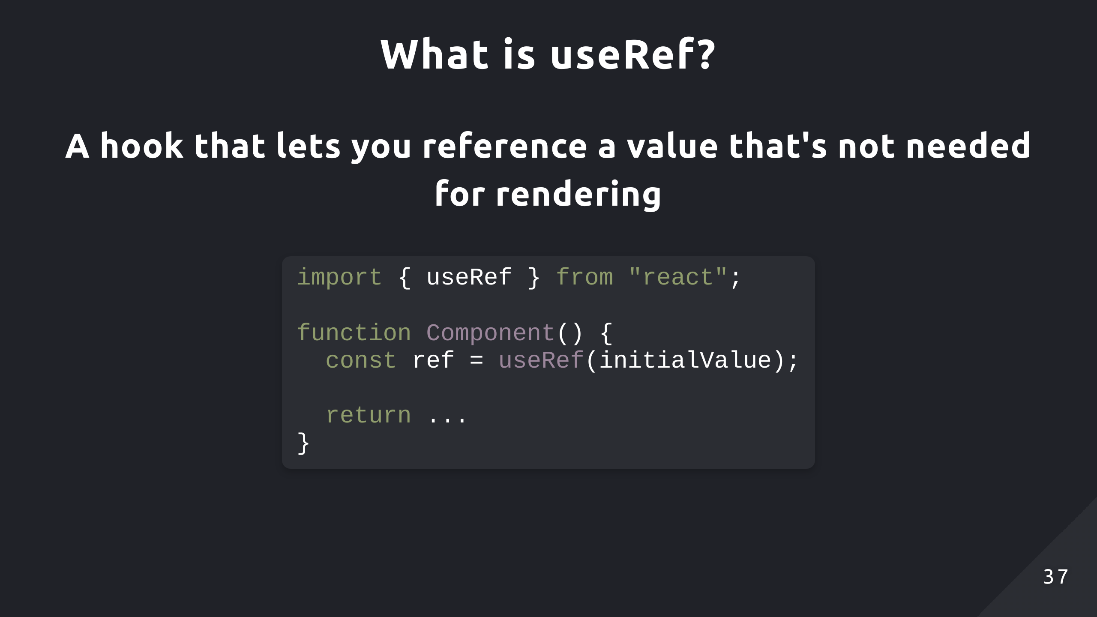

Slide 38
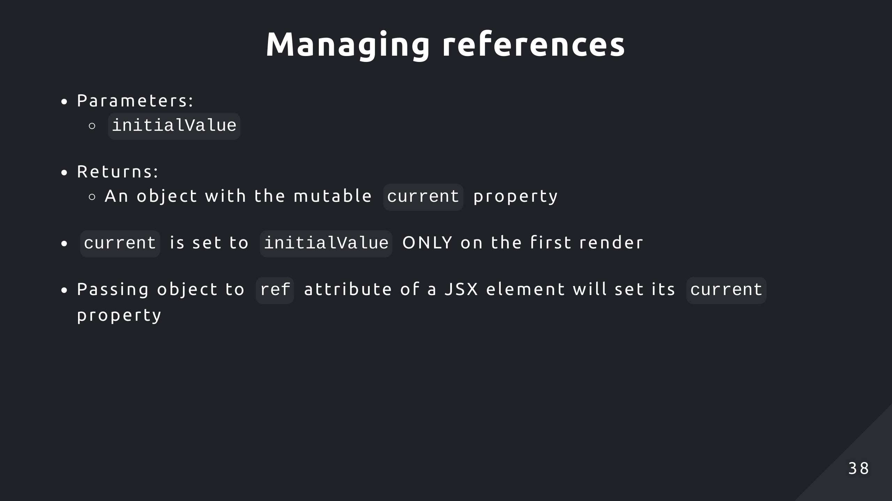
Notes:
Similar to useState, the initialValue is only set to the current property on the initial render
We can also access DOM nodes by passing the object to the ref attribute of a JSX element

Slide 39
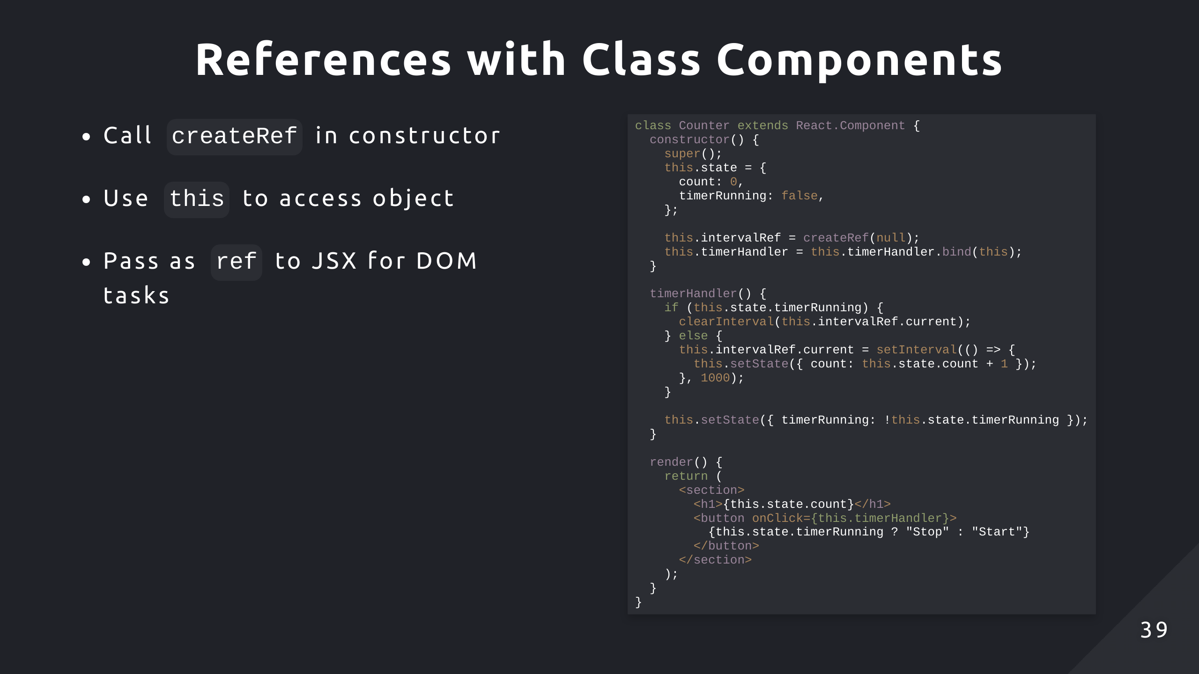
Notes:
I’ve modified the counter quite a bit, it no longer increments based off clicks. Instead, there’s a stopwatch that increments count every second when running. If it’s not running, it doesn’t increment.
We store the id in the reference object so that value persists across re-renders, otherwise that value will be reinitialised

Slide 40
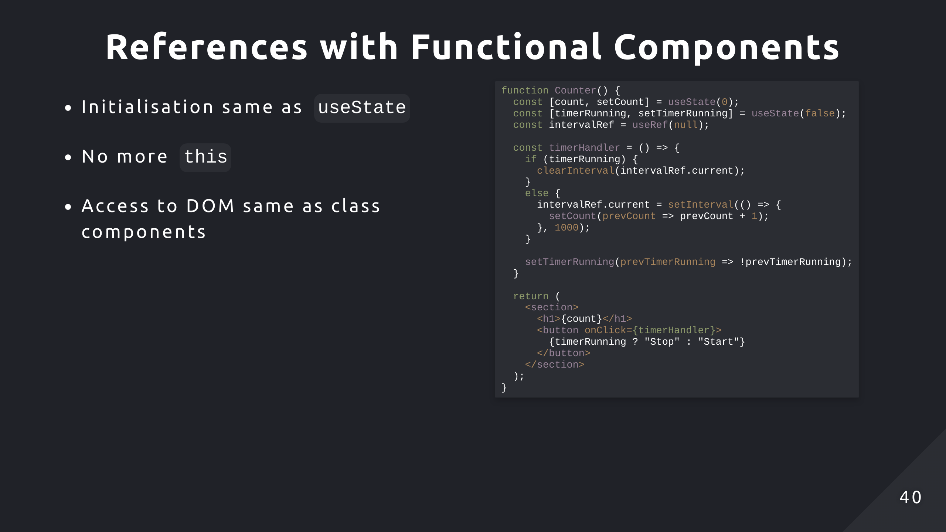
Notes:
Here we have the same functionality with a functional component, apart from using the useRef hook rather than createRef and the lack of this syntax, not much has changed

Slide 41
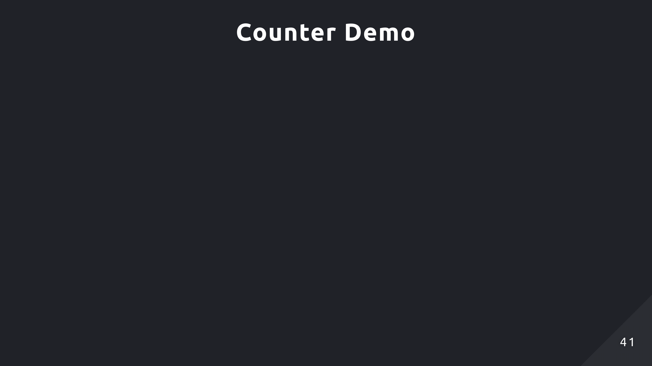
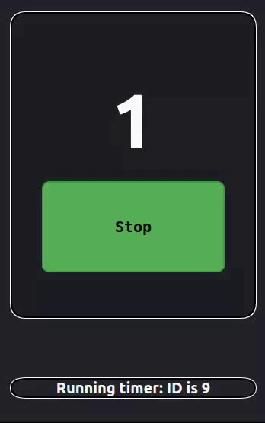
Notes:
Here when the timer is running, it creates a timer function with an ID
When it stops, it uses that ID to clear the timer
Then the process is repeated for every start and stop cycle

Slide 42
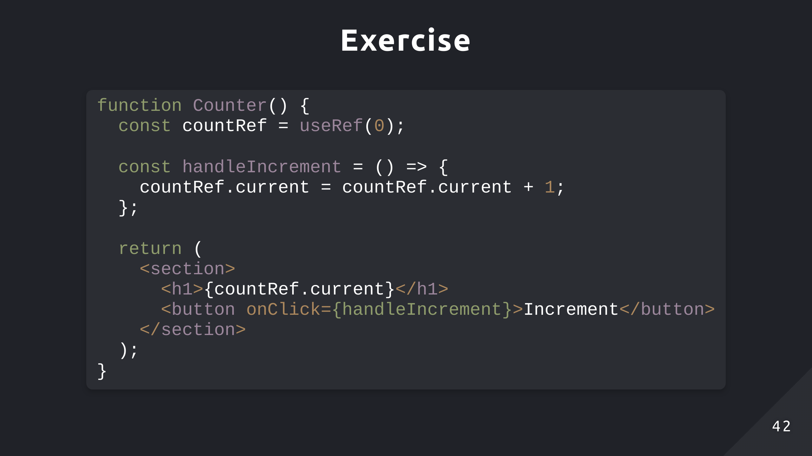
Notes:
For this exercise I’ve simplified the code back down, it just uses a reference object to track the counter instead. It’s going to display the count and increment it when a button is clicked. Can you tell me what’s wrong with this code?

Slide 43
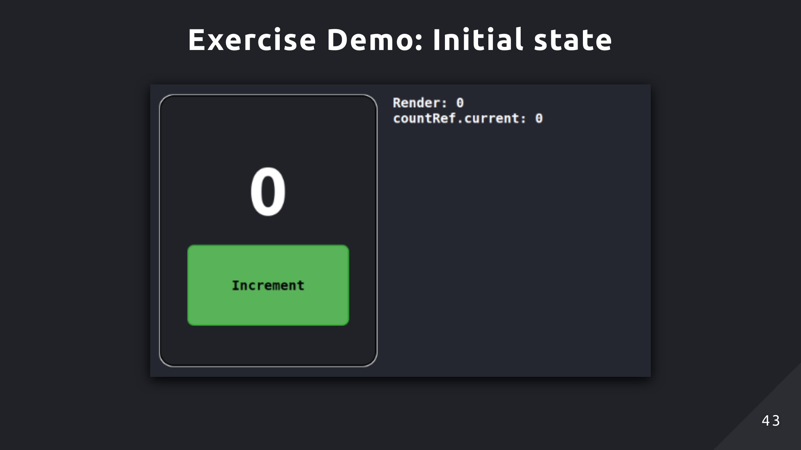

Slide 44
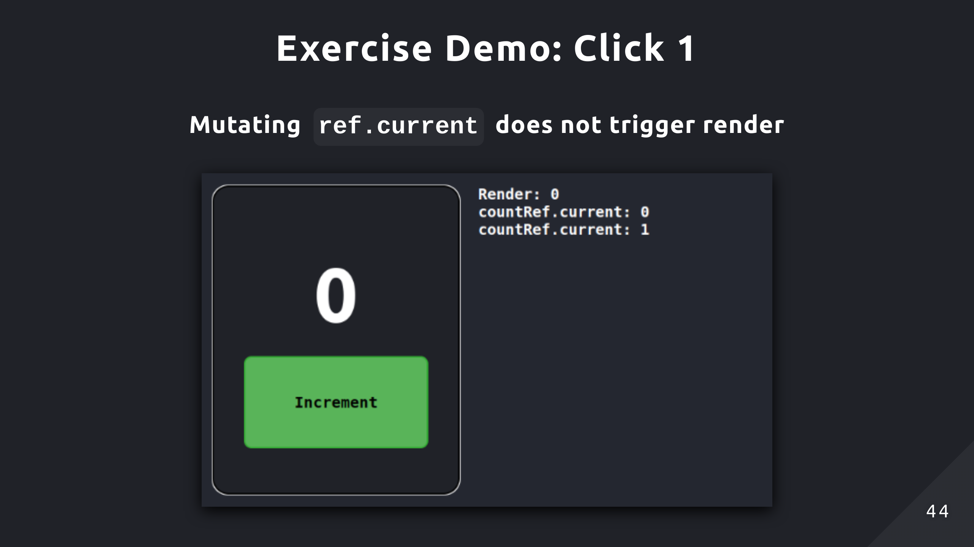
Notes:
Here you can see countRef.current updated to 1, but it doesn’t show that in the UI. That’s because mutating the reference object doesn’t trigger re-renders unlike state. So the UI is never updated to reflect that change

Slide 45
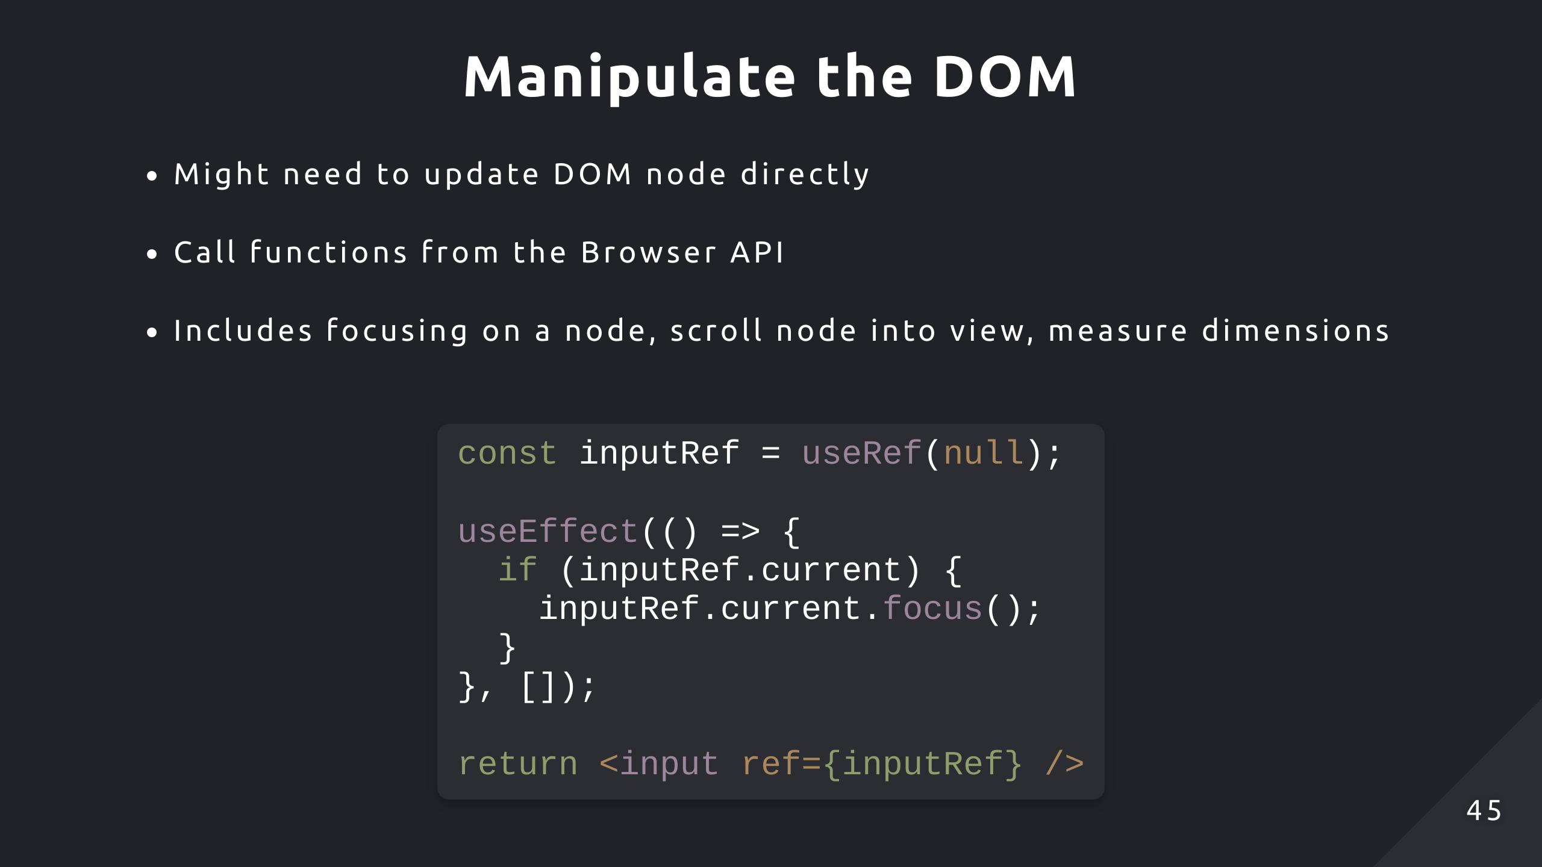
Notes:
The most common use of useRef is for DOM manipulation
React typically handles all the updates to the actual DOM but there are times when there’s no in-built functionality to do certain things
So in this case, you want direct access to a DOM node

Slide 46
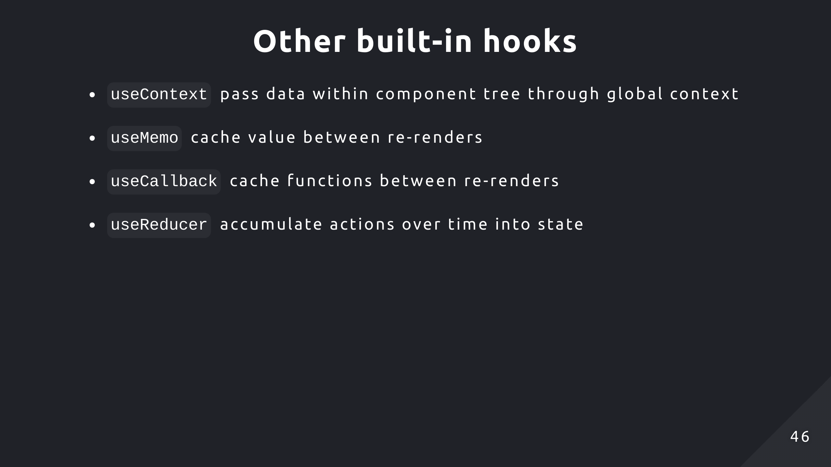
Notes:
UseReducer is another way to manage state. If you tend to find yourself updating multiple pieces of state at the same time because they are dependent on each other, consider using this hook to extract that complex state update logic into a reducer function

Slide 47


Slide 48
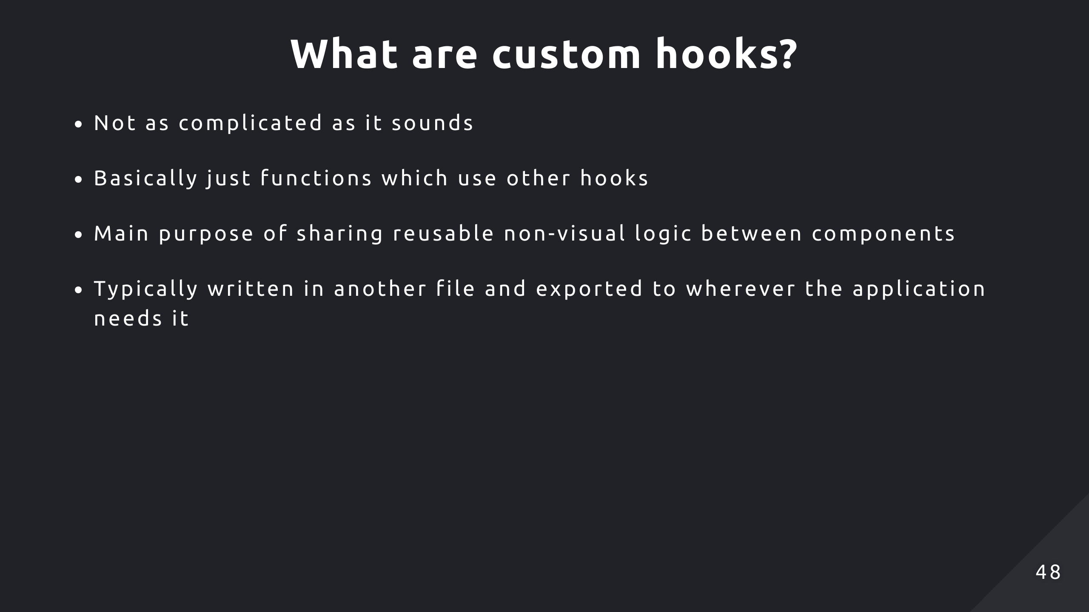

Slide 49
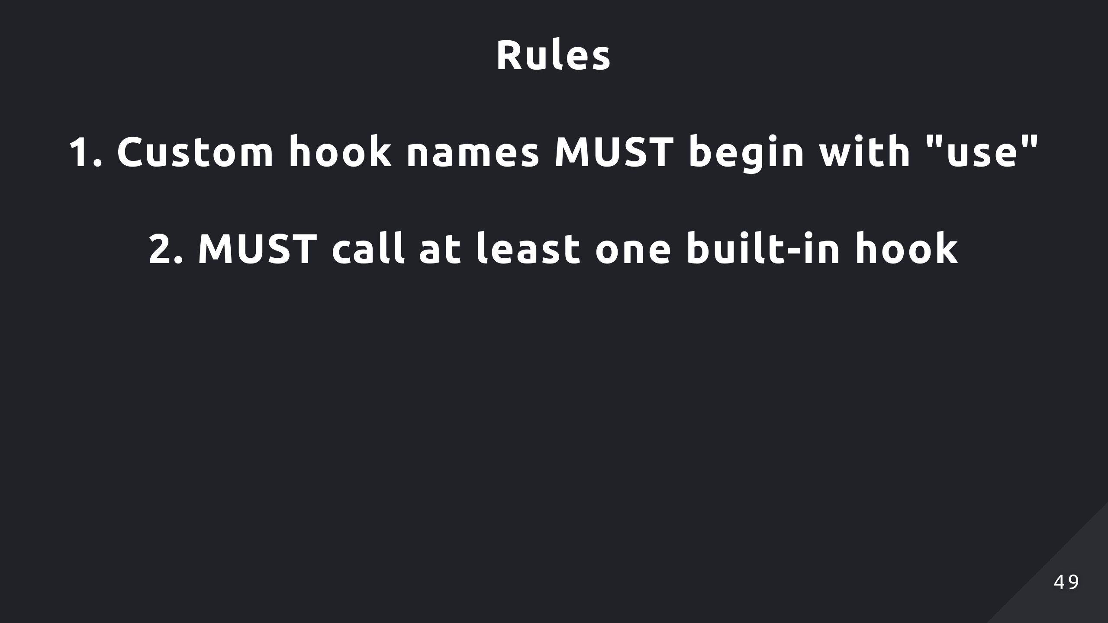
Notes:
Might get warning or error from linter

Slide 50
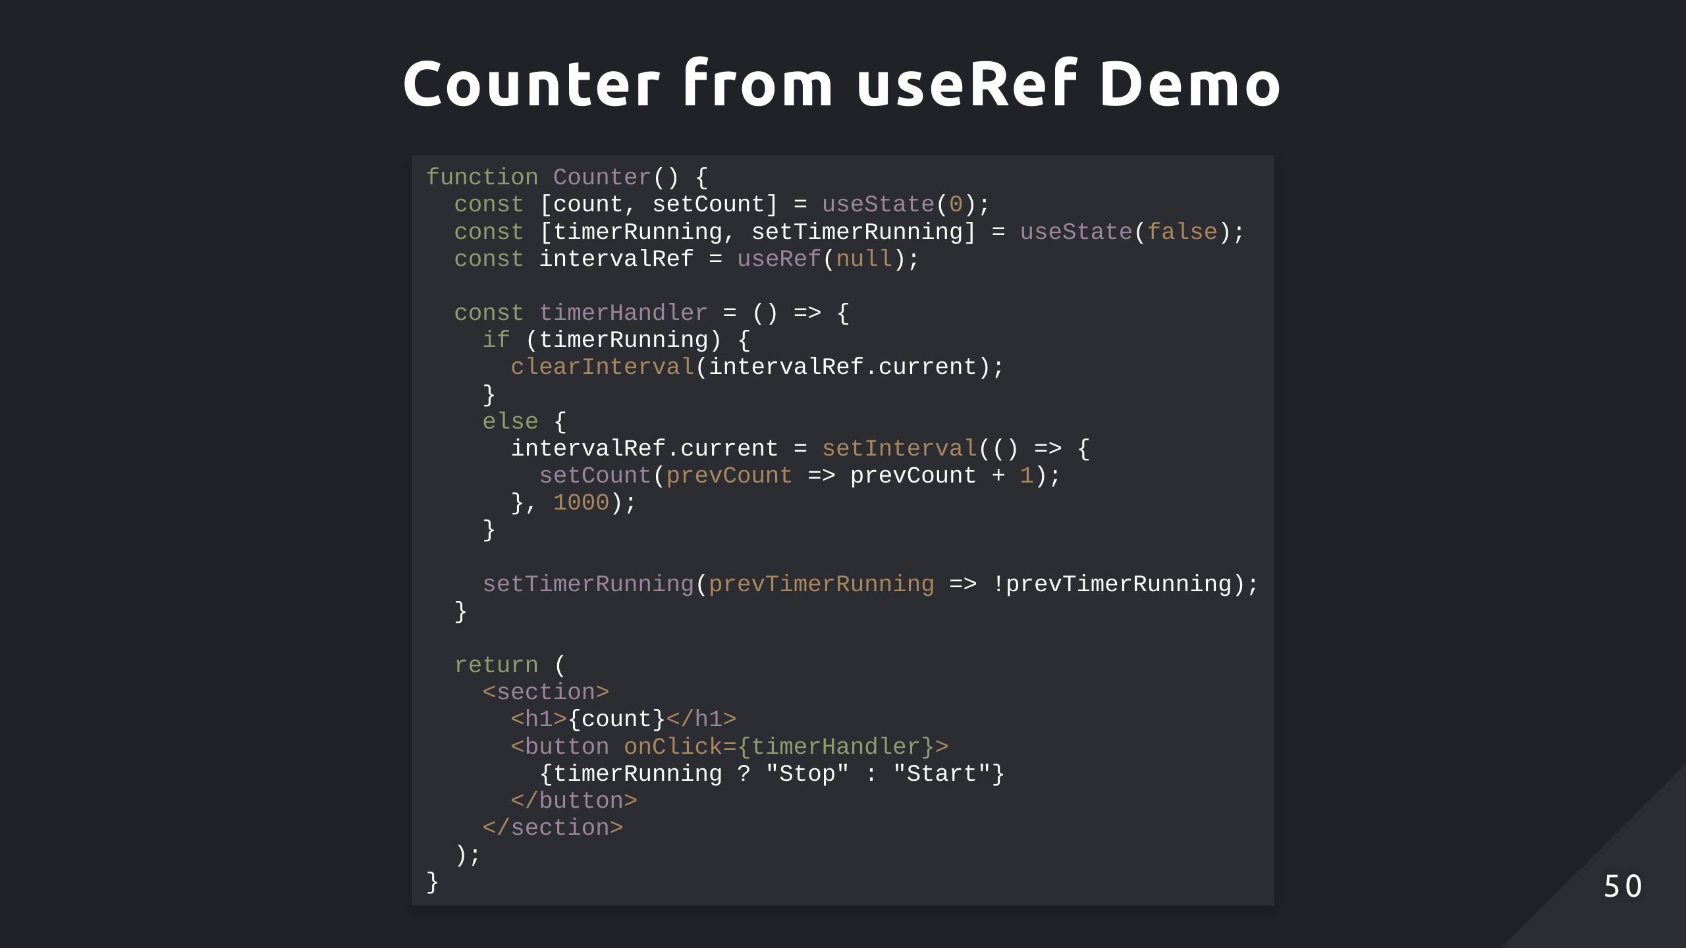
Notes:
Consider the demo from the useRef section, the logic can be extracted into simpler and reusable hooks

Slide 51
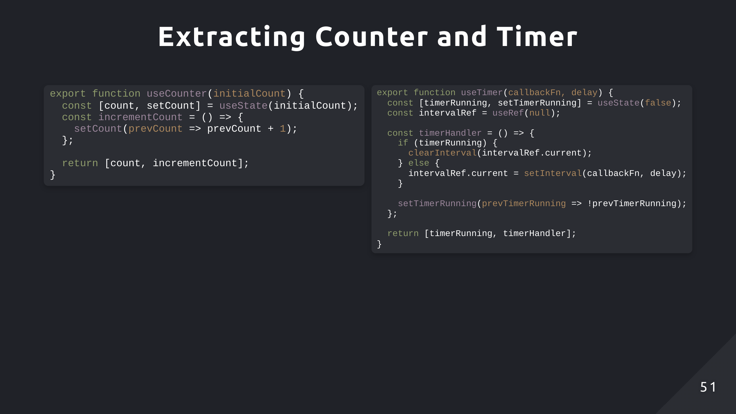
Notes:
Here we have two custom hooks, useCounter and useTimer
UseCounter will return the current state and a function to increment that state
UseTimer is basically a stopwatch that invokes some callback function every delay amount of time, but only if it’s running. And that returns the boolean state, timerRunning and a function to toggle the timer
Both hooks also can also be applied more generically now, useCounter and useTimer don’t have to be used together now. They can be used in other components if need be

Slide 52
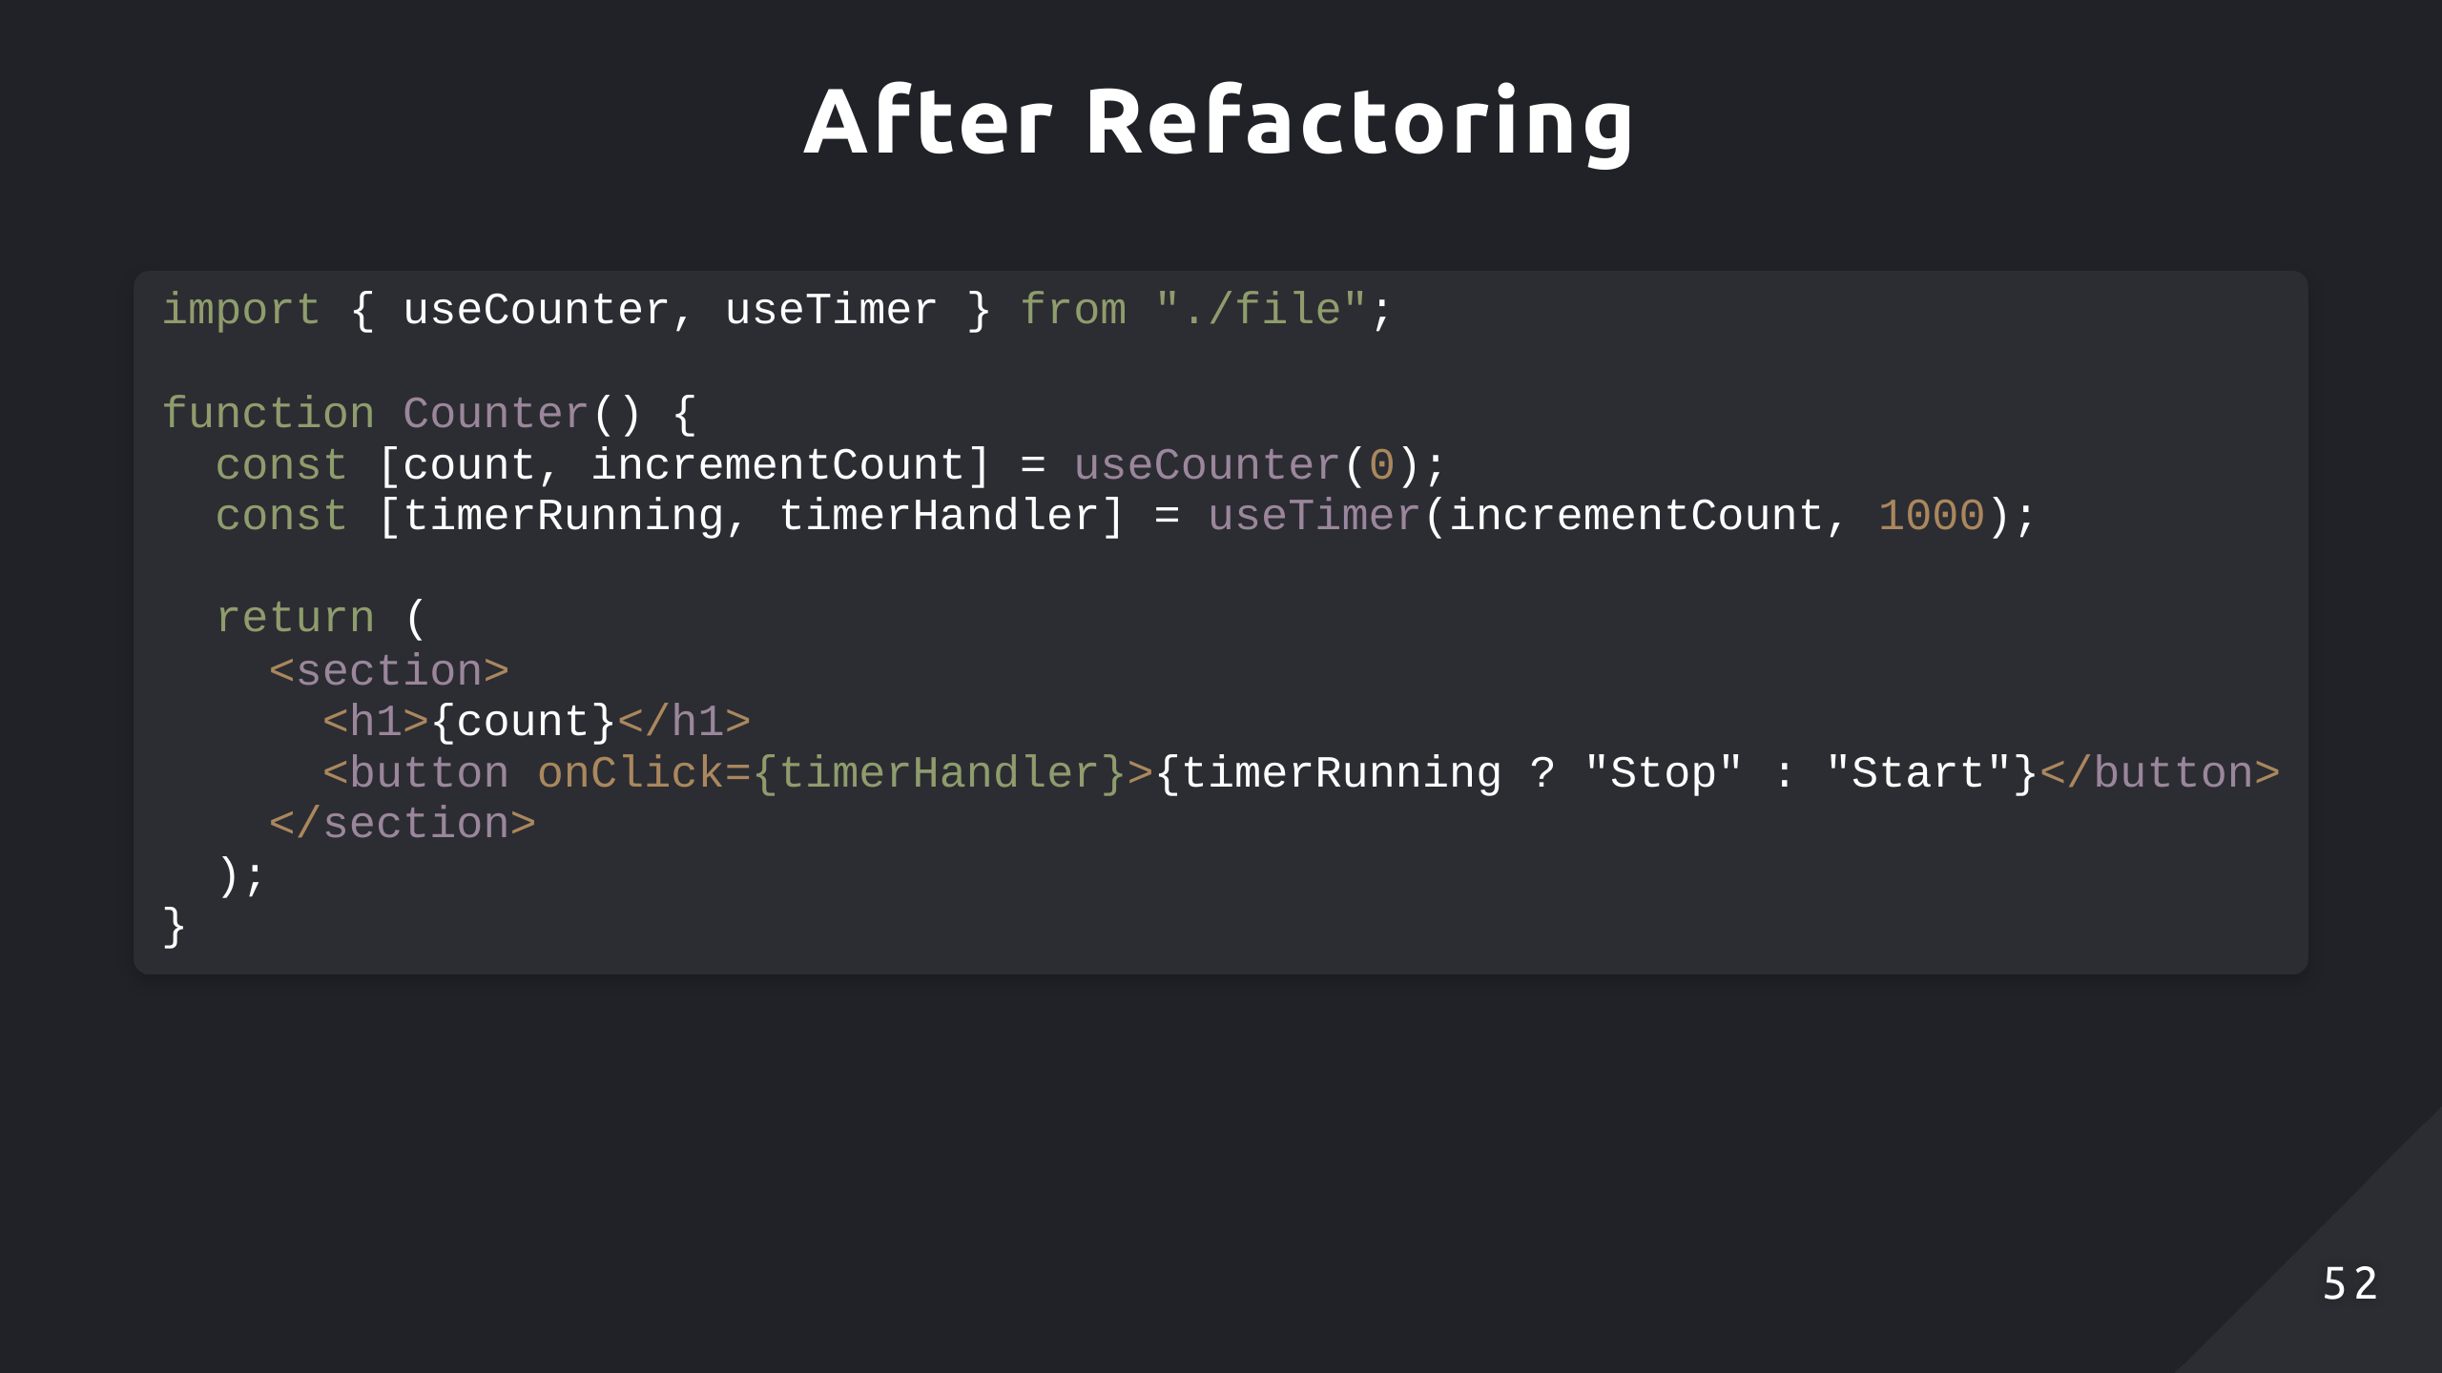

Slide 53
